Slide 1
Moorpark College and Guided Pathways
An Update
Nenagh Brown, Julius Sokenu, Amanuel Gebru
November 25, 2017

Slide 2
What is Guided Pathways?
See website!
http://www.moorparkcollege.edu/faculty-and-staff/professional-development/guided-pathways
Collect handouts

Slide 3
Moorpark College and Guided Pathways What we have done so far . . .
April ‘17: Introduction to Guided Pathways by Rob Johnstone
August ‘17: Presentation on Guided Pathways at Bakersfield College
August ‘17: Moorpark team visit to Mount San Antonio College

Slide 4
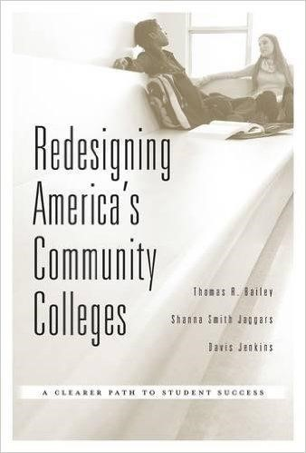
Moorpark College and Guided Pathways What we have done so far . . .
Sept-Nov ‘17: Book group discussions on Redesigning
America’s Community Colleges
October ‘17: ‘Y’All Come’ on Guided Pathways
Nov-Dec ‘17: Adhoc GP Workgroup meetings

Slide 5
The CA Chancellor’s Office and Guided Pathways
May ’17: Budget Revise - $150m for Guided Pathways
Oct ‘17: Budget allocated to colleges
Moorpark’s total over 5 years: $1,091,668
(Year 1: $272,917)
Oct ‘17: Three steps required to obtain funding

Slide 6
The CA State Chancellor’s Office and Guided Pathways Timeline
Oct ’17: Attendance at Guided Pathways Workshop
Dec ‘17: Submit College Guided Pathways Self Assessment
(“Early Adoption Plus”)
3. Mar ‘18: Submit College Guided Pathways Multi-Year Plan

Slide 7
Moorpark College and Guided Pathways What we are doing right now . . .
Guided Pathways Update Meeting
Advertising for 2 Guided Pathways faculty leads for Spring
Academic Senate Council starting discussion on Guided Pathways resolution n
Defining focus areas for Multi-Year Plan

Slide 8
Expand program mapping to help clarify the paths for our students Jill McCall

Slide 9
Explore the concept of “meta-majors” and its suitability for our students Traci Allen

Slide 10
What is a Meta Major? Meta-majors, sometimes referred to as career clusters or communities of interest, group individual majors under a larger academic umbrella. These programs provide students with a clear pathway to graduation, and help them make connections between their studies and different career tracks. Within each Meta-Major are degrees and certificates that have related courses. The intent of selecting a Meta-Major is to help students choose a major and degree based on their interests, knowledge, skills and abilities.

Slide 11
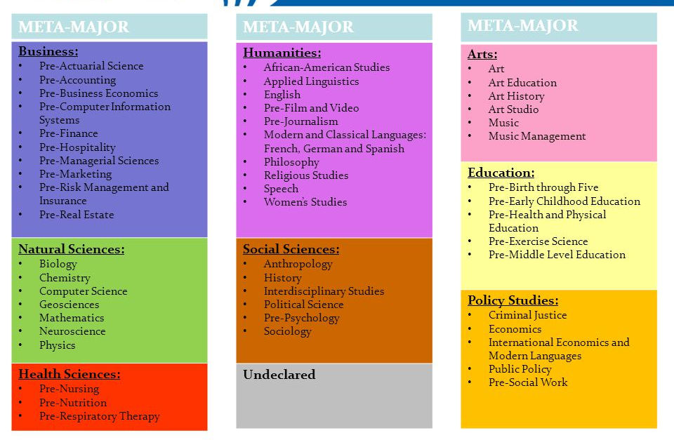
Helping Students Make Clear and Informed choices…
VS.

Slide 12
Extend the support services provided to our GPS students to other student populations Jesus Vega

Slide 13
GPS Checkpoints
Full time status
Math and English
College Strategies Course (Fall)
Summer Kickoff
Early Access to Counselors
Monthly meeting with Student Success Coach
Meet with Academic Counselor to update Educational Plan
Summer Kickoff

Slide 14
Grow our dual enrollment program April Montes

Slide 15
Moorpark College and Guided Pathways Structure for Multi-Year Plan?
GP Steering Group
2 GP Faculty Leads
4 GP Workgroups on areas of focus

Slide 16
Moorpark College and Guided Pathways What Can You Do?
Find out more about Guided Pathways
Consider applying to be a faculty lead? Contributing to a workgroup?
Jan 19: Attend Guided Pathways Forum with Rob Johnstone
Join Academic Senate Council discussion of guided pathways resolution

Slide 17
Moorpark College and Guided Pathways THANK YOU FOR COMING!
For further information:
Moorpark College GuidedPathways website:
http://www.moorparkcollege.edu/faculty-and-staff/professional-development/guided-pathways
Julius Sokenu (jsokenu@vcccd.edu)
Amanuel Gebru (agebru@vcccd.edu)
Nenagh Brown (nbrown@vcccd.edu)

