Slide 1
ADHD and Autism:
Promoting Neurodiversity in the College Classroom
Kara Lybarger-Monson
Moorpark College, English Professor
klybargermonson@vcccd.edu
Multicultural Day 2018

Slide 2
Background
ADHD and ASD are neurological disorders
Research shows that the disorders have 50% genetic and 50% environmental causes
The rates are on the rise
They impact individuals across ALL gender, racial, ethnic, and socioeconomic backgrounds
They have a high rate of coexisting conditions
Every person is absolutely unique

Slide 3
A Case for Neurodiversity
Neurodiversity is the idea that having individuals with autism, ADHD, and other neurological disorders in the classroom and workplace is an
advantage and contributes to
diversity initiatives and
inclusionary practices.

Slide 4
Article in Harvard Business Review
Gary P. Pisano of Harvard Business School
“Their intellectual horsepower is quite high. They do things differently and they behave differently, but the question is, can you turn that into a virtue? That’s part of the thinking on this idea of neurodiversity; that we do better when we mix people who think differently or are wired a bit differently” (qtd. in Holland).

Slide 5
The Spectrum of Success
Promote neurodiversity and ensure equity:
  Use effective instruction strategies
  Address different learning styles
  Increase one’s general understanding of these neurological disorders

Slide 6
Rising Rates of ADHD and ASD
ADHD diagnosis has increased:
  7.8% in 2003
  9.5% in 2007
  11.0% in 2012
ASD diagnosis has increased:
  One in 150 in 2000
  One in 68 in 2010

Slide 7
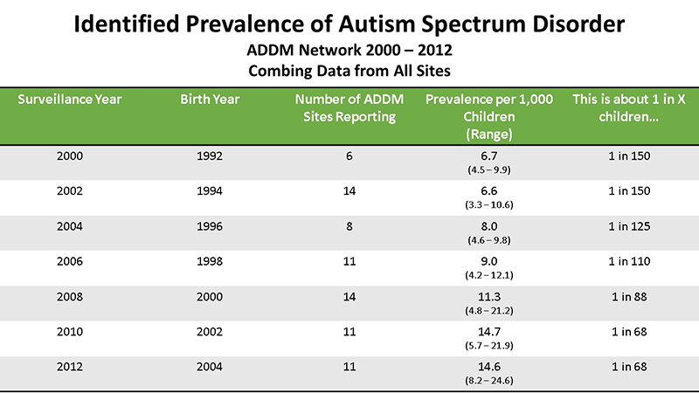
Centers for Disease Control and Prevention: Study of 8-year-olds

Slide 8
Definition of Autism Spectrum Disorder (ASD)
ASD is primarily a social relational disorder and the definition includes two symptoms:
Restricted, repetitive behavior
Deficits in social interaction and communication
These students have trouble with the following:
Executive Functions (order of hierarchy)
Theory of Mind (shared perception/situational awareness)
Central Coherence (the big picture)

Slide 9
ASD Behaviors and Traits
Social challenges – may not always respond in expected ways with peers
Difficulties with communication – may misunderstand facial expressions or tone of voice
Sensory sensitivities
Tendency to engage in repetitive behaviors
May have specialized area of interest
Highly intelligent and most place in the average to above-average range

Slide 10
Definition of Attention-Deficit/Hyperactivity Disorder
Attention-Deficit/Hyperactivity Disorder is primarily an executive functioning disorder and a self-regulation disorder and includes two main categories:
Poor sustained attention
Hyperactivity-impulsiveness
Core symptoms are inattention, hyperactivity, and impulsivity

Slide 11
ADHD Behaviors and Traits
Short attention span
Disorganized
Procrastinates
Easily distracted
Poor follow through

Slide 12
Similar Traits: ASD and ADHD
Low working memory
Lack of executive functioning skills, such as being able to see the big picture and understand the appropriate hierarchy of tasks
Need assistance in organizational and time management skills
Difficult time transitioning
Difficulties in social relationships with their peers
Possess an excellent long-term memory for areas of interest and mastered subjects

Slide 13
How to Help
Use audiovisual aids, graphic organizers, and timelines to complete assignments.
Diagram steps for planning and organizing to complete larger tasks.
Use transitional cues to move between activities in the classroom.

Slide 14
ADHD and ASD students thrive in environments that are organized, consistent, and low key:
High rate of sensory perception disorder with ASD

Slide 15
English, Meta-Studies, the 1990s
In a comprehensive study of the literature published in 2013 about learning disabilities in the college classroom from 1990 to 2000, the researchers found that…
the use of computers to type essays helped students the most along with peer-response, portfolios, self-reflection assignments, and assistive technologies along with work on basic writing skills and emotional support.

Slide 16
English, Meta-Studies, 2000s
The authors analyzed 53 studies and focused on text production skills as the best areas to help students: Sentence fluency, handwriting, spelling, and grammar. The writing process is complex!
“It requires the orchestration of handwriting, typing, spelling, and sentence construction skills that allow for composing to take place; strategies for planning, evaluating, monitoring, drafting, and revising text; topic, genre, linguistic, and semantic knowledge for creating meaning; and the motivational aspirations to put these skills, strategies, and knowledge into play.”

Slide 17
High Rate of Comorbidities
One-third of students with ADHD:
Learning disabilities (most common, dyslexia)
Coexisting psychiatric disorders at a higher rate than the average student without
Some comorbid behaviors are depression, anxiety, compulsive behaviors, and oppositional defiant disorders.
70 percent of adults with autism have at least one additional disorder: Social anxiety, ADHD, and oppositional disorder

Slide 18
Positive Aspects of ASD
The Wisconsin Technical College disability staff created an “Autism Spectrum Disorders Guide” for instructors:
Perseverance
Rarely judges others
Not distracted by social cues or random small talk
Attention to detail and sustained concentration
Excellent long-term memory
Honest and loyal
Tolerance of repetition and routine
Ability to think outside the box and find creative solutions

Slide 19
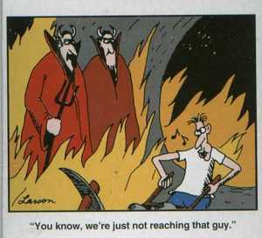
The far side

Slide 20
Positive Aspects of ADHD
Hyperfocus
Resilience
Risk-taking
Spontaneity
Creativity
Out-of-the-box thinking

Slide 21
Best Practices: ASD
Visual learners: Balance lectures with audiovisuals and use graphic organizers
Be consistent and organized
Minimize or be aware of bright lights, loud sounds, and strong smells.
Allow assignments to be typed due to fine motor skills
Prime students for transitions
Provide lecture ahead of time or on the back end

Slide 22
Best Practices: ADHD
10-2 strategy
Reduce the amount of timed tests
Scaffolding: Break down assignments
Hands-on-learning strategies
Kinesthetic/Auditory Activities:
  Share/Pair/Square
  Jigsaw

Slide 23
Teach to the Seven Different Learning Styles
Listening and taking notes while paying attention will address the visual, tactile, and auditory aspects of learning
Using the board or manipulatives will help the tactile (or kinesthetic) learner

Slide 24
Con’t
Working individually will help the intrapersonal learner while groupwork will encourage the interpersonal learner to succeed
Repeating what was said in lecture and presenting findings from the group will assist the linguistic learner and providing the logical background or reasoning of what is being learned will help the logical learner

Slide 25
Autism in the Workplace
In May of 2013, SAP, an Internet technology company, started an Autism at Work program as part of their Diversity and Inclusion division:
“We focus on everyone’s unique ability to contribute, rather than a person’s perceived limitations . . . SAP’s internationally-recognized Autism at Work program is a shining example of this commitment, with nearly 120 colleagues on the autism spectrum onboard and the program in nine countries. By embracing differences, we help spark innovation — while challenging assumptions and inspiring change.”

Slide 26
Who inspired SAP?
Specialisterne is a software company who employs individuals on the spectrum and was started by a man whose son is autistic:
“We harness the special characteristics and talents of people with autism and use them as a competitive advantage, and as a means to help people with autism secure meaningful employment.”

Slide 27
ADHD and the Workplace
Highly routine environments may be boring compared to varied and unpredictable environments that are more stimulating and fast-paced.
Short attention span, restlessness, and impatience are assets in this environment.
Weill Cornell Medical College clinical psychiatry professor Richard A. Friedman says in a New York Times article, “Let’s not rush to medicalize, their curiosity, energy and novelty-seeking; in the right environment, these traits are not a disability, and can be a real asset.”

Slide 28
Neurodiversity Promotes Equity
These neurological disorders impact students across all gender, racial, ethnic, and socioeconomic backgrounds.
By using inclusionary practices in the classroom, instructors may promote neurodiversity and ensure equity.

Slide 29
In Conclusion …
"Be a little flexible. Be a little creative. We have to rethink, what is the end goal in education?"
Dr. Temple Grandin
For more information, please contact me at klybargermonson@vcccd.edu

Slide 30
Sources
American Psychiatric Association. Diagnostic Statistical Manual of Mental Disorders (DSM-V), 2013.
“Attention-Deficit/Hyperactivity Homepage.” Centers for Disease Control and Prevention, 2017, https://www.cdc.gov/ncbddd/adhd/index.html. Accessed 30 August 2017.
“Autism Spectrum Disorder Homepage.” Centers for Disease Control and Prevention, 2017, https://www.cdc.gov/ncbddd/autism/data.html. Accessed 30 August 2017.
“Autism Spectrum Disorders Quick Guide.” Wisconsin Technical College System, 2015.
Friedman, Robert A. “A Natural Fix for A.D.H.D.” The New York Times, 31 Oct. 2014, https://www.nytimes.com/2014/11/02/opinion/sunday/a-natural-fix-for-adhd.html.
Graham, Steve, et al. “Writing Characteristics of Students with Learning Disabilities and Typically Achieving Peers: A Meta-Analysis.” Exceptional Children, vol. 83, no. 2, 1 Jan. 2017, pp. 199-218. EBSCO Host, search.ebscohost.com/login.aspx?direct=true&bd=eric&AN=EJ1125287&site=ehost-live. Accessed 17 Sept. 2017.
Harris Delrieu, Laura. “Students with Autism in the College Classroom.” The HEATH Resource Center at the National Youth Transitions Center, George Washington University, 2013, https://www.heath.gwu.edu/students-autism-college-classroom. Accessed 1 September 2017.
Holland, Roberta. “Neurodiversity: The Benefits of Recruiting Employees with Cognitive Disabilities.” Harvard Business Review, 11 July 2016, https://hbswk.hbs.edu/item/neurodiversity-the-benefits-of-recruiting-employees-with-cognitive-disabilities.
SAP. “Differently Abled People.” https://www.sap.com/corporate/en/company/diversity/differently-abled.html.
Specialisterne. “Welcome to Specialisterne.” http://specialisterne.com/.
United States, Department of Education. Teaching Children with Attention-Deficit/Hyperactivity Disorder: Instructional Strategies and Practices, 2008, https://www2.ed.gov/rschstat/research/pubs/adhd/adhd-teaching-2008.pdf.

