Slide 1
FIRST STEPS!
OEI CONSORTIUM &
COURSE EXCHANGE
Moorpark College
DE Committee, April 26, 2017
Joanna Miller, DE Coordinator

Slide 2
FOR CONSIDERATION TODAY:
Should the Academic Senate recommend in concept that Moorpark College join the Online Education Initiative Consortium when it opens to non-pilot colleges in Fall 2017? (DE Committee approved 4-26-17)
NOTE: Not a formal agreement. Before any formal agreements:
Formation of Implementation Team
Discussions with AS, Student Services, management, & all affected
Collaboration with IT to integrate systems (IT has endorsed)
Memoranda of understanding – District-level contracts
v

Slide 3
ONLINE EDUCATION INITIATIVE What and who is it???
Funding: 5-year $56.9 million grant from the CCC Chancellor’s Office in 2014
Purpose:
To improve online education throughout the 113 California Community College
To improve student success online
Leadership: Led by a team hired from community colleges around the state

Slide 4
ONLINE EDUCATION INITIATIVE Governance Structure
*NOTE: Steering Committee includes 6 members from the California Academic Senate

Slide 5
ONLINE EDUCATION INITIATIVE GOALS
Significantly increase CCC student transfer to 4-year institutions
Increase student completion through system collaboration in providing access to quality online courses and support services for students, faculty, and colleges
Create economies of scale in resource and technology acquisition

Slide 6
ONLINE EDUCATION INITIATIVE PROJECTS
Select and financially support single course management system
Provide support services for students, faculty, and colleges
Create system-wide course exchange to allow students to fill in needed courses to complete degrees

Slide 7
OEI Consortium Resource Development
Faculty Resources
Course Design Standards*
Online Course Design Rubric
Professional Development
Applying the Course Design Rubric#
Canvas Online Course
Self Paced
Facilitated
Train-the-Trainer
Design to Align
Online Standards and Practices
Guidance
Course Review Process
Instructional Designers
Accessibility Support
Effective Practices Resources
Guidelines for use of publisher materials
Student Success Resources
Tutoring*
Student Readiness*
Online Support Resources
Just-In-Time-Help*
Additional Resources (ready 5/2016)~
List of Resource*
Embedded Basic Skills Guide*
Proctoring#
Digital/ Proctorio
On-Campus Network (developing)
Counseling#
Network
Platform
Professional Development Course
Technology Tools
Canvas
24/7 Help Desk*
103 Colleges with
Course Exchange
Developed Business
Launched with 5 Pilots and 5 Courses Spring 2017
Support Materials:
Information on the course exchange on the website: http://ccconlineed.org/
OEI Informational Videos. https://www.youtube.com/playlist?list=PLGnFKrzE75OTxtR9Wl-4555UiKVnoYvYB

Slide 8
OEI Consortium and Course Exchange
Course Exchange Purpose: To allow CCC students to seamlessly complete degrees with courses from through the 113 CCC system
Home college establishes residency, enrolls students, receives credit for the degree completion and/or transfer attained, provides enrollment, financial aid and other external services
Teaching college also establishes residency*, receives apportionment for enrollments, provides services for students inside classes.
*Currently working with CCC Chancellor’s Office to revise to allow only Home College to establish residency.

Slide 9
OEI Consortium and Course Exchange
Advantages:
Allows students to enroll in one college and take classes at others with single enrollment, sign-on, transcripts, etc.
Allows faculty to fill courses that might not otherwise fill

Slide 10
Benefits of the OEI Course Exchange
Access to “hard-to-get” courses needed to graduate or transfer
Exchange courses seamlessly articulate between colleges (specified C-ID, ADT courses)
Examples of streamlined processes for students:
Streamlined application and registration processes
Financial aid combined across colleges in the Exchange
Course status and transcript data shared back to Home College (credit toward degree or transfer goal)
Students and faculty use a Common Common Course Management System (Canvas)

Slide 11
OEI Course Exchange Current Status
Launched in Spring 2017
Only open to 24 OEI initial pilot schools
Currently 5 pilots with 5 courses
Courses currently are offered with majority of seats for Home College, and 5 seats for Teaching College
Set to open to non-pilot schools in Fall 2017
v

Slide 12
Current courses approved for Exchange Criteria expanded for Fall
United States History from 1865
Introduction to Statistics
Introduction to Philosophy
Introduction to American Government and Politics
Introductory Psychology
Introduction to Research Methods in Psychology
Introduction to Research Methods in Psychology (With Lab)
Introduction to Sociology
Introduction to Research Methods
Introduction to Criminal Justice
Introduction to Cultural Anthropology
Child Growth and Development
Intercultural Communication
Principles of Microeconomics
Principles of Macroeconomics
College Composition
Introduction to Human Geography
Physical Geology
United States History to 1877

Slide 13
Criteria for new Exchange Courses
Offered by Consortium college
Taught in Canvas course management system
C-ID designation
Part of an ADT, IGETC Transfer Pattern, or CTE Pathway
Mathematics, English, and ESL courses must be transfer-level
Any prerequisites align with C-ID
Fully online with the possible exception of on-campus proctored exams.

Slide 14
Current status at Moorpark College
)
MC Distance Ed Committee approved resolution April 26, 2017 to recommend joining the Consortium
May 2, 2017 Academic Senate considers whether to recommend beginning process to join the Consortium
If we proceed, an Implementation team is formed, MOU developed, parameters set
v

Slide 15
AFTER joining the Consortium Process to submit a course)
Apply the Rubric to your course as closely as you can
Work with a peer reviewer at MC
Submit to the OEI
Two OEI course reviewers check for alignment with rubric
OEI lead course reviewer determines alignment, suggests fixes
Faculty meets with OEI Lead Reviewer, discusses findings
OEI Course Designer meets with faculty to fully align course, including making course fully accessible
Course enters Exchange with a designated number of seats set aside for Exchange (predetermined by MOU, campus deans)

Slide 16
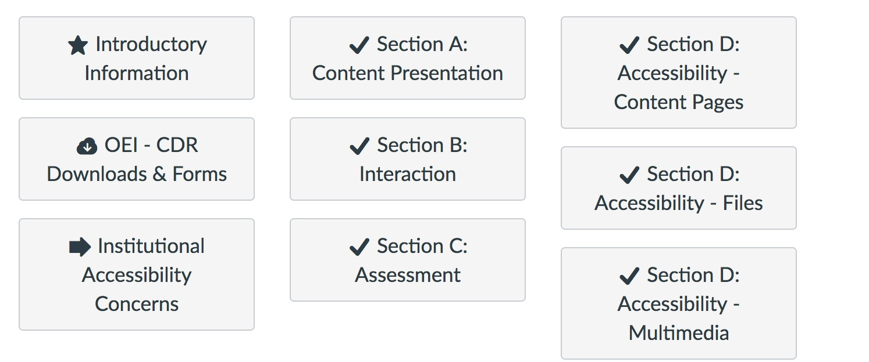
Interactive Online Course Design Rubric
v

Slide 17
Moorpark College FLEX Workshop 4-20-17
Began adding examples of alignment to Google doc
Become pilot implementers of OEI rubric, working over summer to self-align courses
Become faculty mentors for others in Spring 2018!
Fantastic professional development opportunity for all, whether or not planning to submit to Course Exchange
No one is forced; everyone is encouraged
v

Slide 18
Questions from Moorpark College Answers from OEI
v

Slide 19
Q&A answers provided by the leadership team at the Online Education Initiative
Kate Jordahl,
Director of Strategic Planning & Operations
CCC Online Education Initiative (OEI)
https://cccconfer.zoom.us/j/310418165
v

Slide 20
Q&A: Questions from Moorpark College online, onsite, and student services faculty & staff)
Q: Can we decline Student Services resources if we join the OEI Consortium? For instance, let's say Counseling does not want to use Cranium Cafe. Can we decline to use Cranium Café?
A: The goal is fully resourced online classes. To participate in the Consortium, all Exchange online classes must be fully resourced with the appropriate student services support. But that does not mean the college must use the particular vendors that OEI has selected, as long as the classes are fully and comparably resourced.
Q: What are our obligations as a Home College or Teaching College?
A: If it is a registration level service generally the home college will provide that service. There is a clause for collaboration of home and teaching colleges’ DSPS to fully support DSPS student with the home college offering on-site support and the teaching college offering all appropriate “in class” support.
v

Slide 21
Q&A: Questions from Moorpark College online, onsite, and student services faculty & staff)
Q: As a Home College, what obligation do we have in terms of informing our students about opportunities on the Exchange? For instance, are our counselors all required to become acquainted with the Exchange to refer students there?
A: The goal of the exchange is to help students find the classes they need and complete their degrees and transfer goals in a timely manner. All counselors need to be properly educated and informed about the Exchange since the goal of the Exchange is to help students find the classes they need and complete their degree and transfer goals in a timely manner.
Q: Is there any data or means to anticipate the impact of becoming a Teaching College on Student Services?
A: We do not have any data at this time as this pilot launched Spring 2017.
v

Slide 22
Q&A: Questions from Moorpark College online, onsite, and student services faculty & staff
)
Q: If we become part of the OEI Consortium, do ALL of our DE courses (online, hybrid and web-enhanced) get access to all of the services provided by the OEI Consortium, even if the course is NOT an Exchange course. For instance, can I use Proctorio in my non-Exchange class if we join the OEI Consortium?
A: The OEI is negotiating for the best possible prices on all of the services. As many of the services will be jointly paid for by the college and by the grant as well as by cost savings from the negotiations, the choice to use services within classes beyond the exchange and beyond online will be a local decision. As we find out final budgeting and costs, we keep all members of the consortium informed of their options.
v

Slide 23
Q&A: Questions from Moorpark College online, onsite, and student services faculty & staff)
Q: How will pre-requisites be cleared?
A: The Home College would clear pre-requisites. All pre-requisites, or lack of pre-requisites would be in compliance with the Home College policies.
Q: Which College provides DSPS support for students with disabilities, and how would the need for services be recognized at the Teaching College?
A: The Teaching College and Home College DSPS would work together to provide services. The Home College would transfer any DSPS information on necessary accommodations to the Teaching College if the student provides informed consent to share records collected by Home College with Teaching college.
v
Notes:
THESE ARE THE POINTS IN THE CURRENT MOU FOR DSPS
16. Teaching College will accept the Home College’s classification of DSPS (as per Title 5, Section 56006) if the student provides informed consent to share records collected by Home College with Teaching college.
17. The Home College will provide students with any qualified on-campus student support services and accommodations as described in the Academic Accommodations Plan (AAP) required pursuant to Section 56022.
18. Teaching College will provide qualified in-class academic accommodation for Exchange courses being taught by the Teaching College as described in the Academic Accommodations Plan (AAP).
19. The Teaching College and Home College DSPS offices will collaborate to ensure that Exchange students requiring DSPS services, that their needs are met.

Slide 24
Resolution approved unanimously by Distance Education Committee on April 26, 2017
The Distance Education Committee recommends in concept that Moorpark College join the Online Education Initiative Consortium when it opens to non-pilot colleges in Fall 2017, subject to review of the specific requirements of the Consortium agreement and subsequent final memoranda of understanding.
v

Slide 25
Question for AS:
Should the Academic Senate recommend in concept that Moorpark College join the Online Education Initiative Consortium when it opens to non-pilot colleges in Fall 2017, subject to review of the specific requirements of the Consortium agreement and subsequent final memoranda of understanding?
v

Slide 26
Contact
Joanna Miller, Distance Education Coordinator, Moorpark College
JoannaMiller@Vcccd.edu
Thank you!

