Slide 1
DUAL ENROLLMENT PROGRAM MULTI-STEP REGISTRATION GUIDE

Slide 2
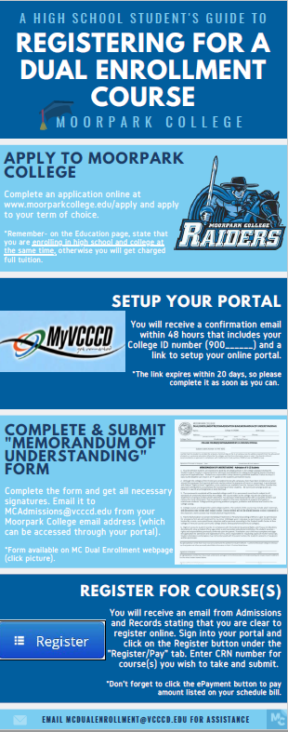
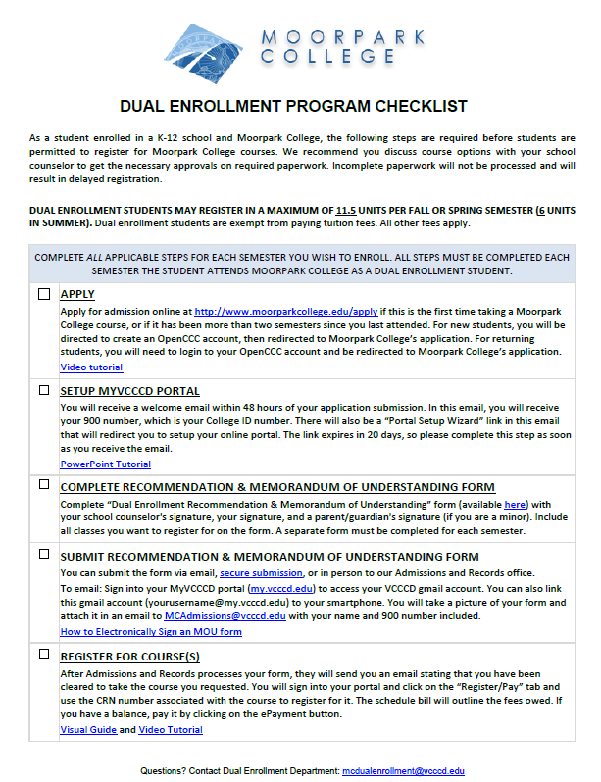
FOUR STEPS TO REGISTER
Step 1: Apply online (click link to start application)
Step 2: Setup your “MyVCCCD” portal
Step 3: Complete and Submit Recommendation/MOU form
Step 4: Register for course through portal
The slides to follow will show you (in depth) how to complete each step
(Click on images to the left and right to be redirected to interactive resources)

Slide 3
STEP 1: HOW TO APPLY
APPLY

Slide 4
APPLY
If you have trouble viewing the video below, you can view it through this link: Step 1: Apply

Slide 5
STEP 2: SETUP YOUR MYVCCCD PORTAL
SETUP PORTAL

Slide 6
ACCESS YOUR WELCOME EMAIL
SETUP PORTAL
WRITE THIS NUMBER DOWN, IT IS YOUR ID NUMBER
CLICK HERE
Click on the “Start the MyVCCCD Setup Wizard” link.

Slide 7
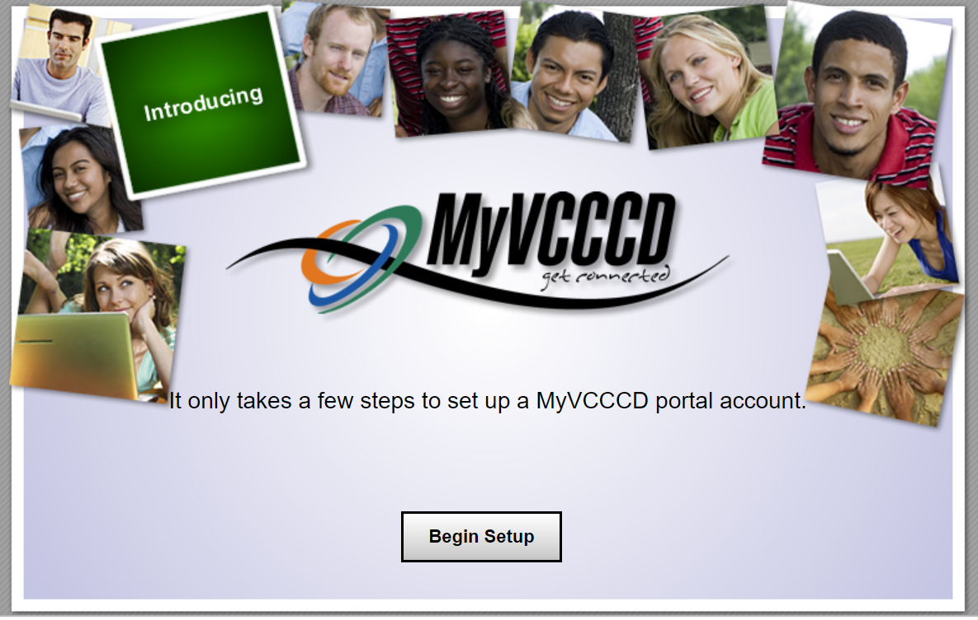
SETUP PORTAL
Click “Begin Setup”.

Slide 8
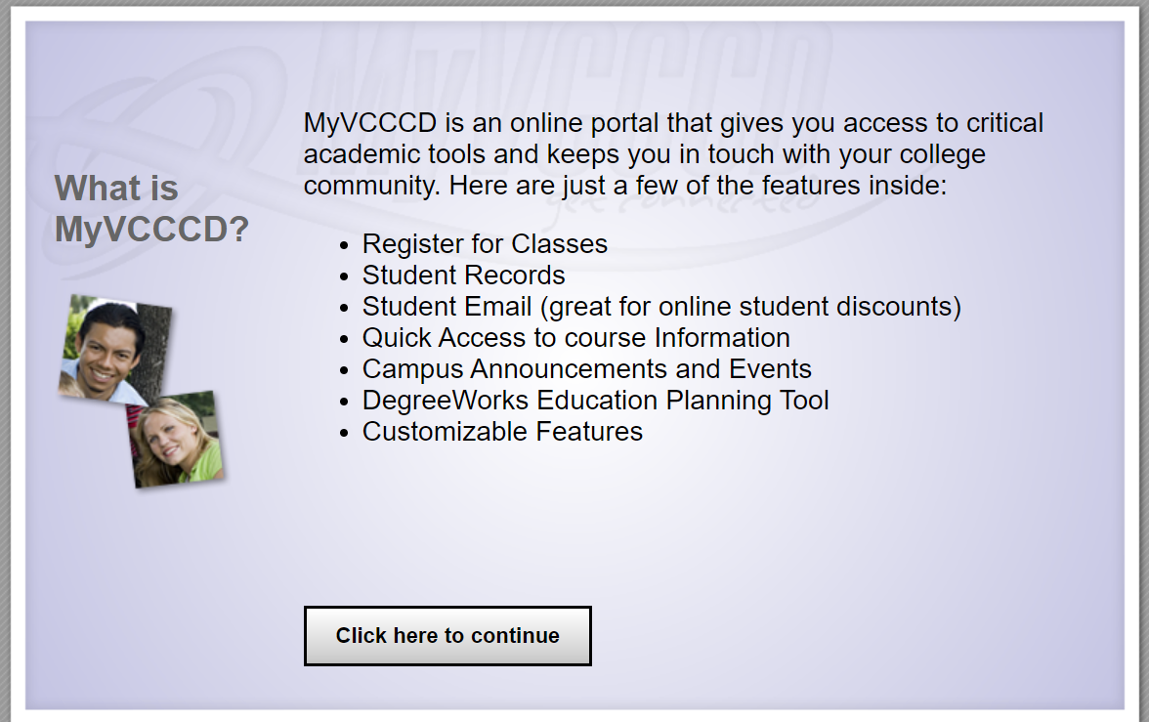
SETUP PORTAL
Read and click to continue.

Slide 9
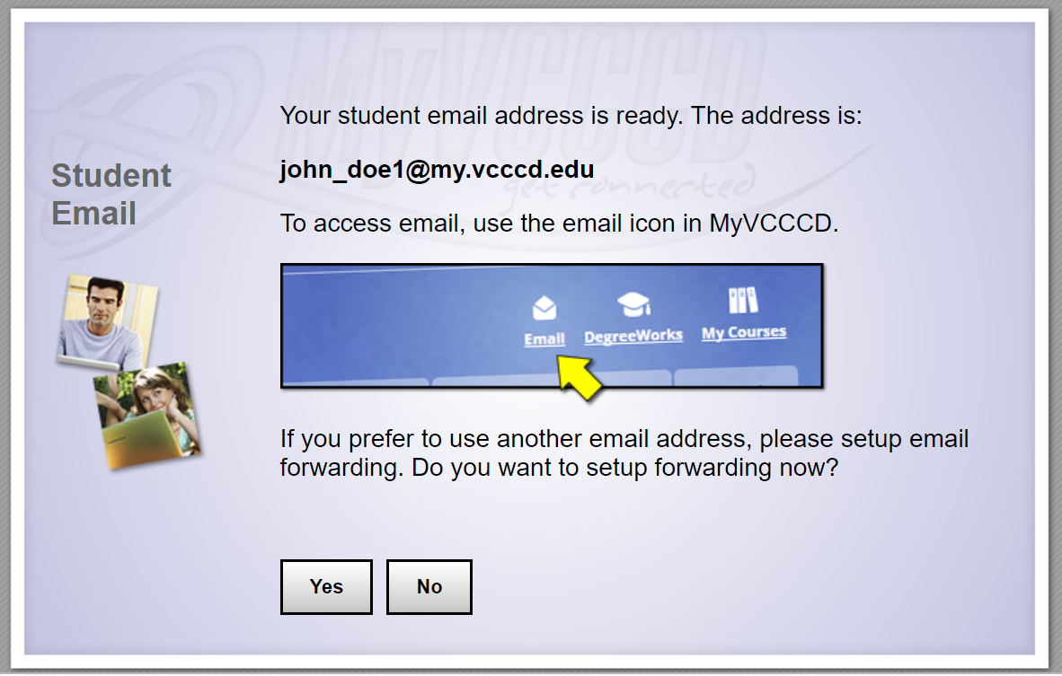
SETUP PORTAL
Click no (you can set this up later in the process).

Slide 10
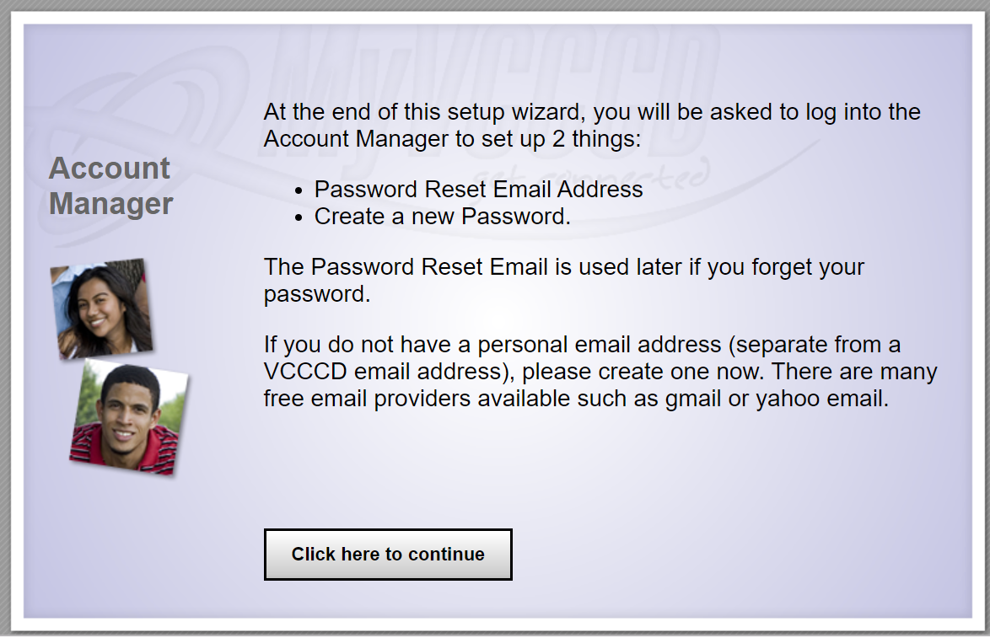
SETUP PORTAL
Read and click to continue.

Slide 11
SETUP PORTAL
Read and click to continue.

Slide 12
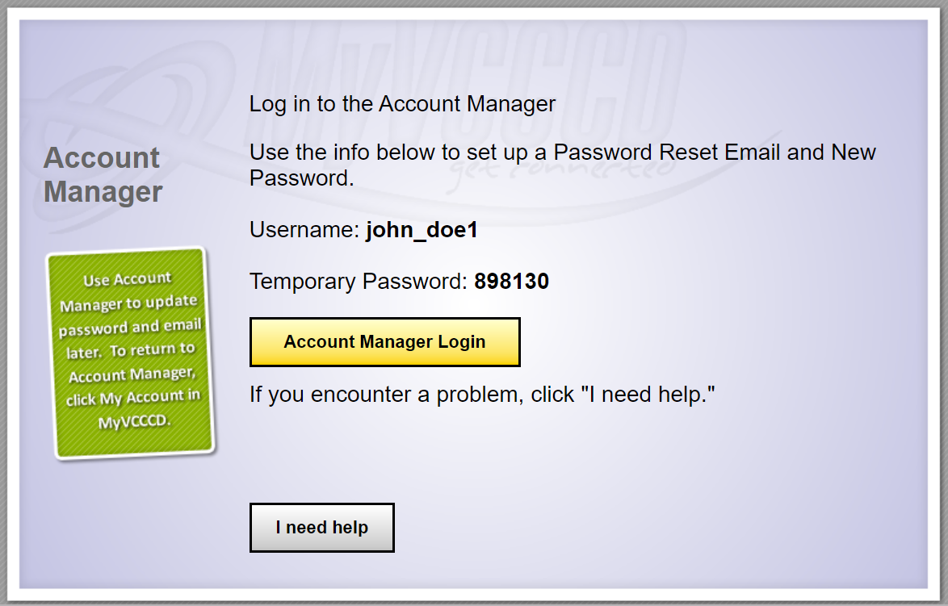
SETUP PORTAL
WRITE THIS DOWN
WRITE THIS DOWN
CLICK HERE
Write down username and temporary password. Click “Account Manager Login”.

Slide 13
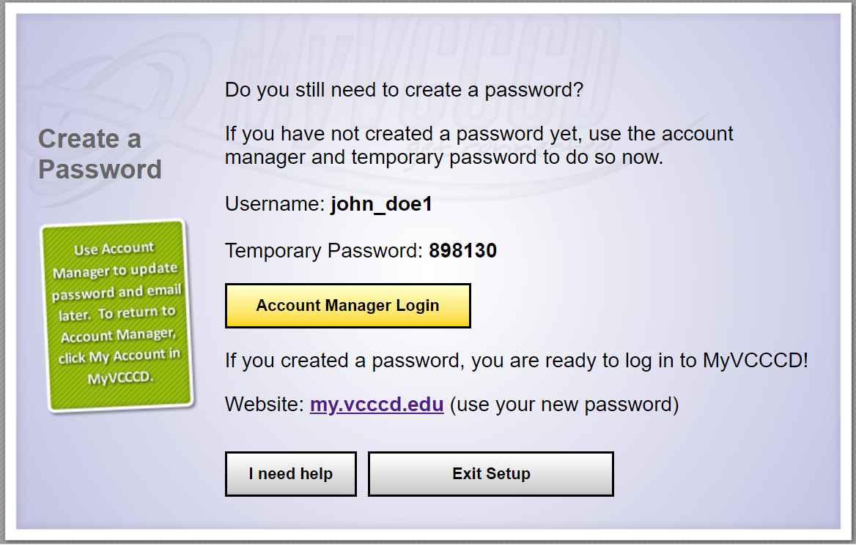
SETUP PORTAL
It might re-route you to a similar looking page. If it does, click “Account Manager Login” again.

Slide 14
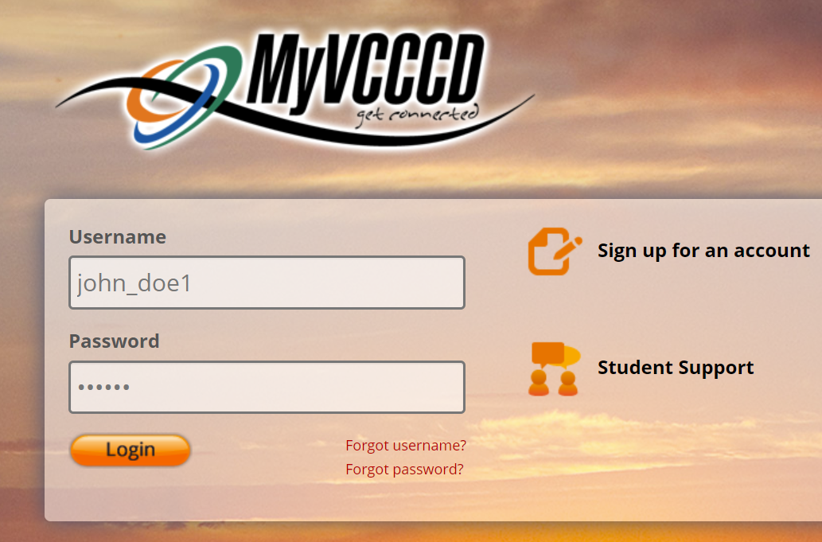
SETUP PORTAL
It will direct you to the MyVCCCD portal. Type in your username and password from prior page (the ones you wrote down) and login. Your username is in the format ”firstname_lastname_number” and will always remain the same.

Slide 15
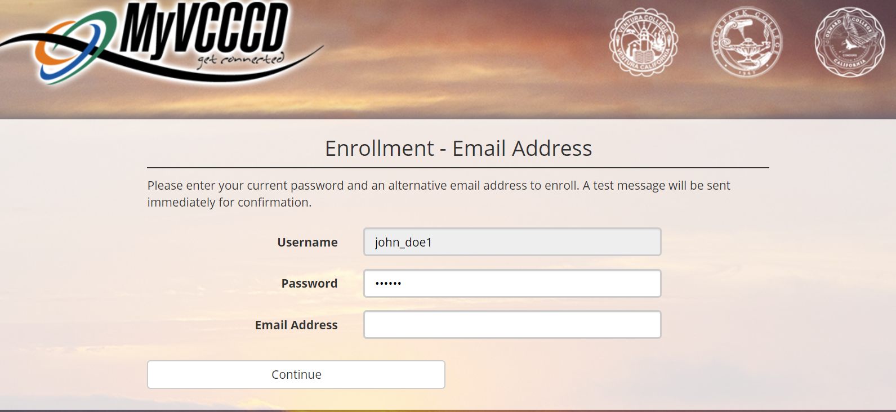
SETUP PORTAL
Type in a backup personal email address to have on file. An email with a One Time Passcode will be sent to it immediately, so make sure it is an email address you have access to right now.

Slide 16
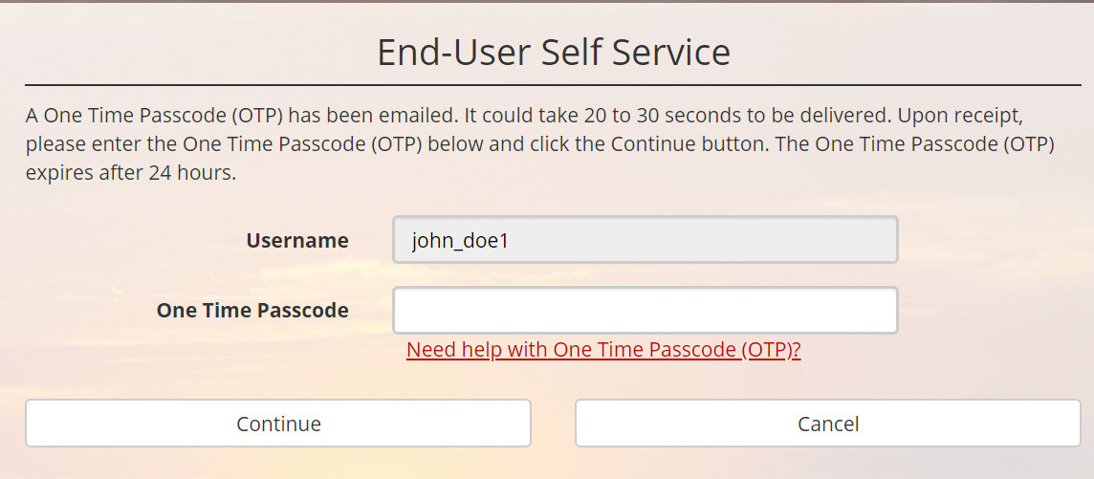
SETUP PORTAL
This page will appear next. Now go to your personal email account inbox to find the One Time Passcode that was sent to you.

Slide 17
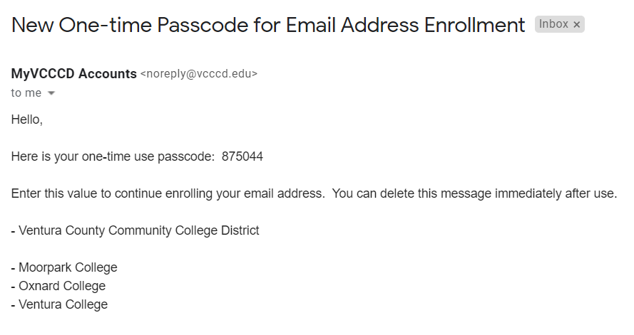
SETUP PORTAL
One Time Passcode
Copy the One Time Passcode in your personal email inbox and return to the setup wizard.

Slide 18
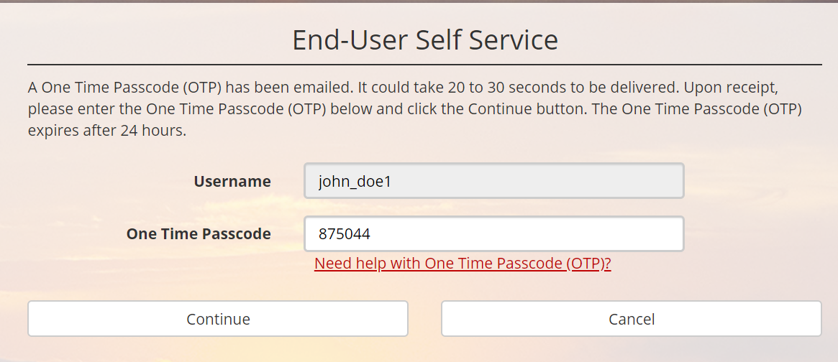
SETUP PORTAL
Enter in the One Time Passcode and press “Continue”.

Slide 19
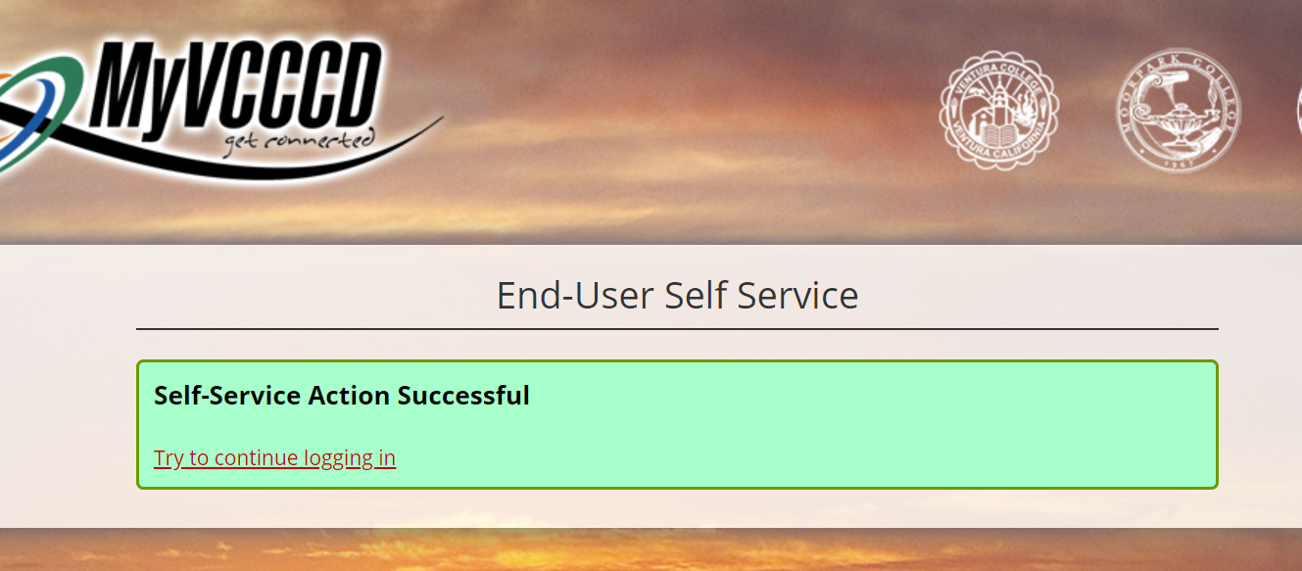
SETUP PORTAL
CLICK HERE
Press “Try to continue logging in” and return to the portal sign-in page. Sign in with your username and original temporary password (not the One Time Passcode from the previous page, but the Temporary Password you initially wrote down.)

Slide 20
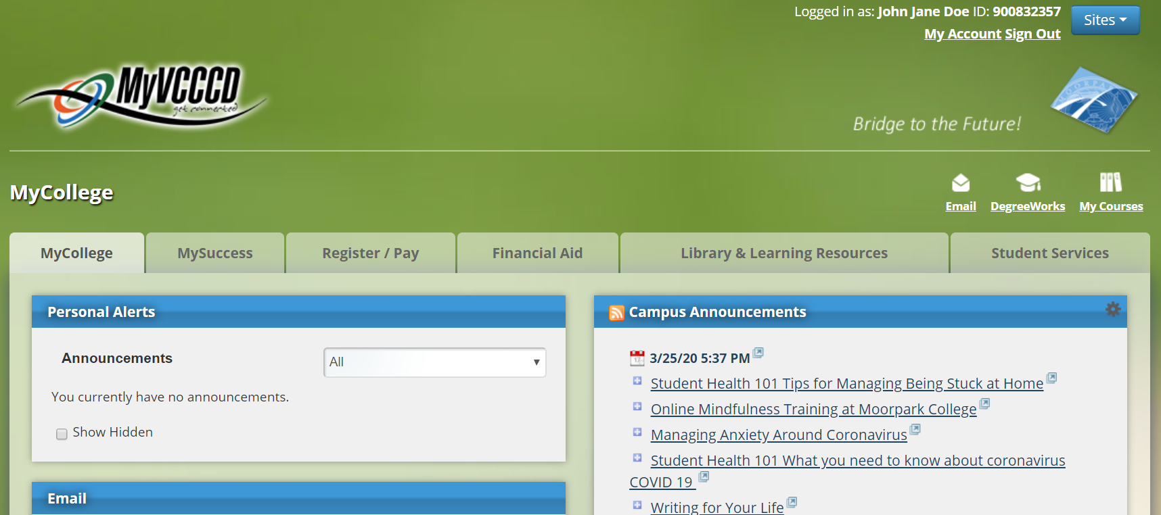
WELCOME TO YOUR PORTAL!
SETUP PORTAL
CLICK HERE
Click on “My Account” at the top right to change your temporary password.

Slide 21
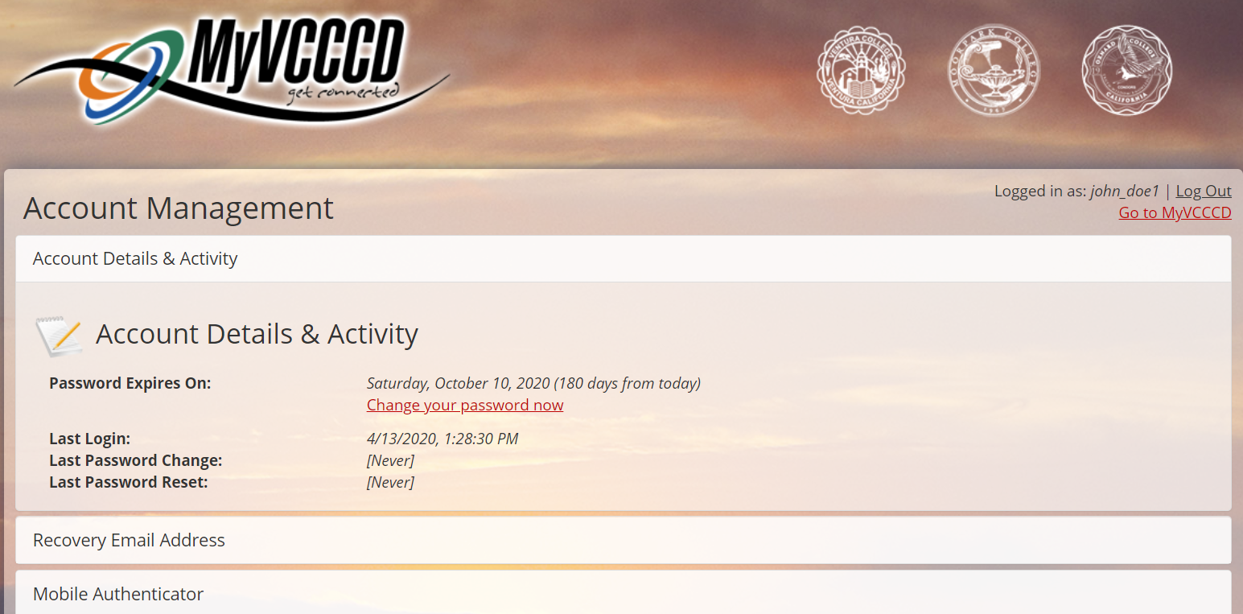
SETUP PORTAL
CLICK HERE
Change your password by pressing “change your password now” link.

Slide 22
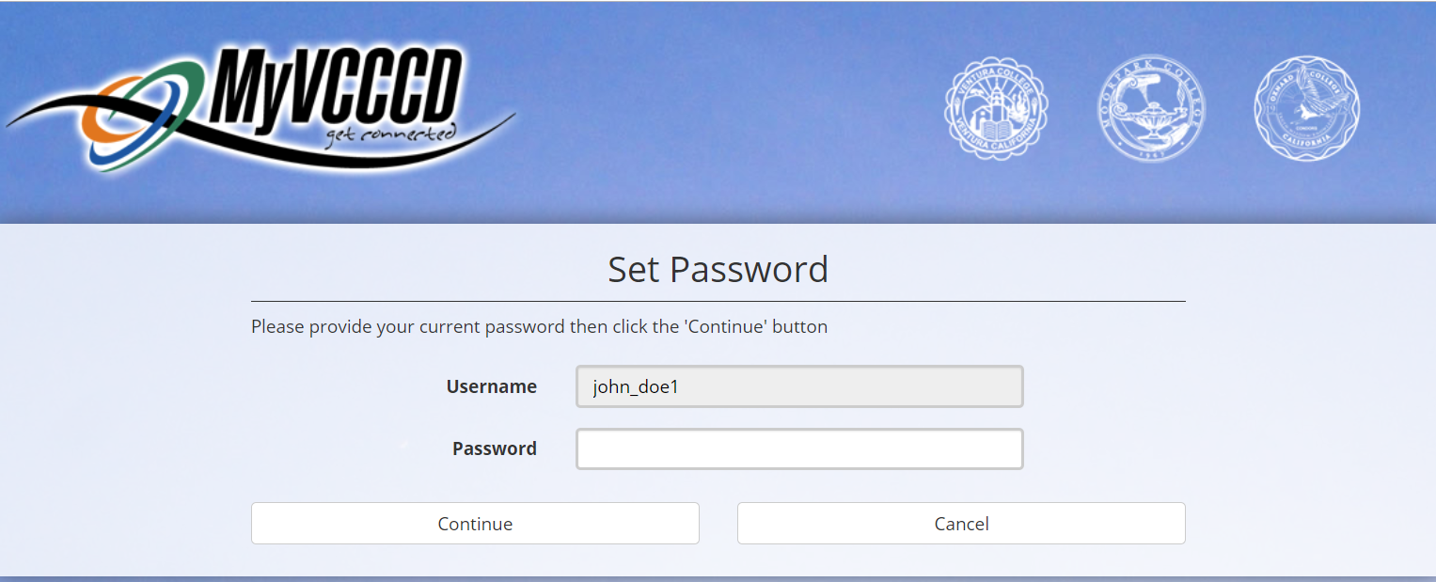
SETUP PORTAL
Type in Temporary Password (the one you wrote down at the beginning with your username). Press continue.

Slide 23
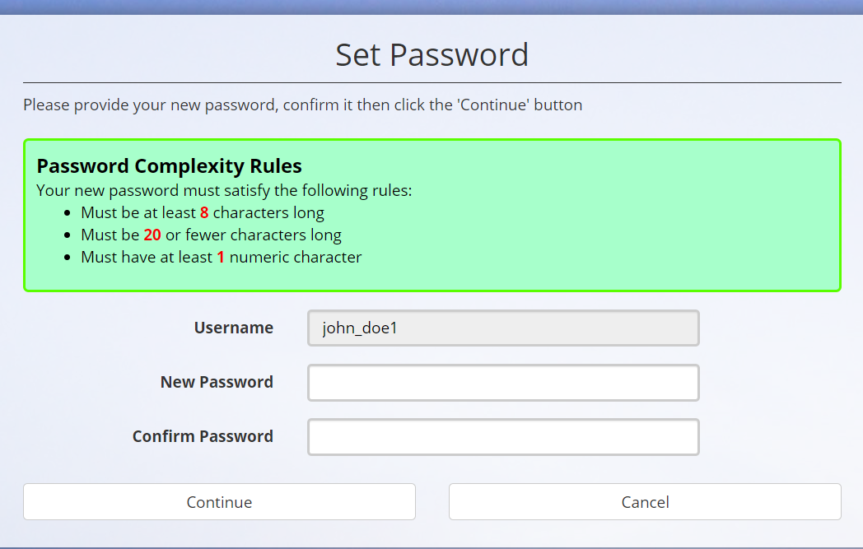
SETUP PORTAL
Create password that satisfies rules in green box.

Slide 24
SETUP PORTAL
CLICK HERE
Press “Return to the Account Management Page”. You’re done setting up your portal.

Slide 25
STEP 3: SUBMIT RECOMMENDATION/MOU FORM
SUBMIT FORM

Slide 26
HOW TO ELECTRONICALLY SIGN FORM
SUBMIT FORM
Click here to download:
Recommendation for Dual Enrollment/MOU Form
Click here for instructions:
How-To Electronically Sign MOU Guide

Slide 27
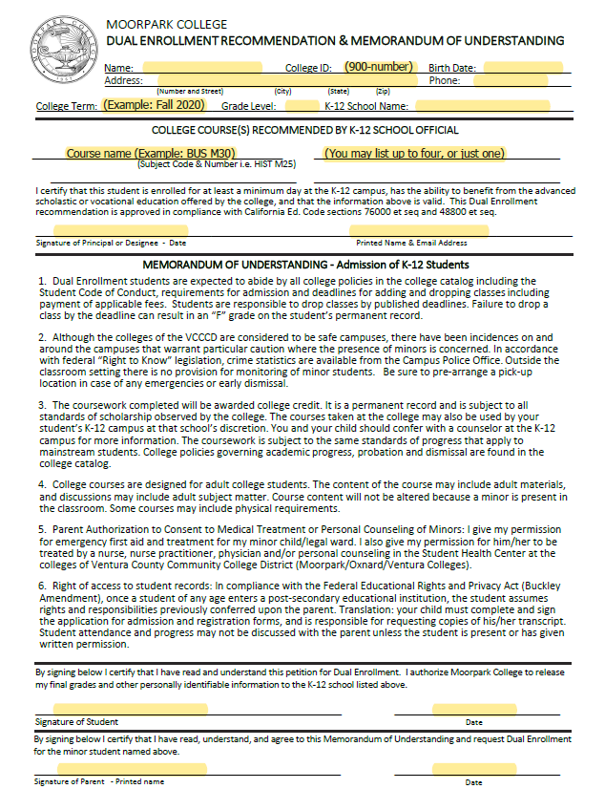
COMPLETE MOU FORM IN ITS ENTIRETY
SUBMIT FORM
Not completing every portion of the form will delay the registration process and require you to submit it more than once.
ALL HIGHLIGHTED AREAS (in image on the left) NEED TO BE COMPLETED.

Slide 28
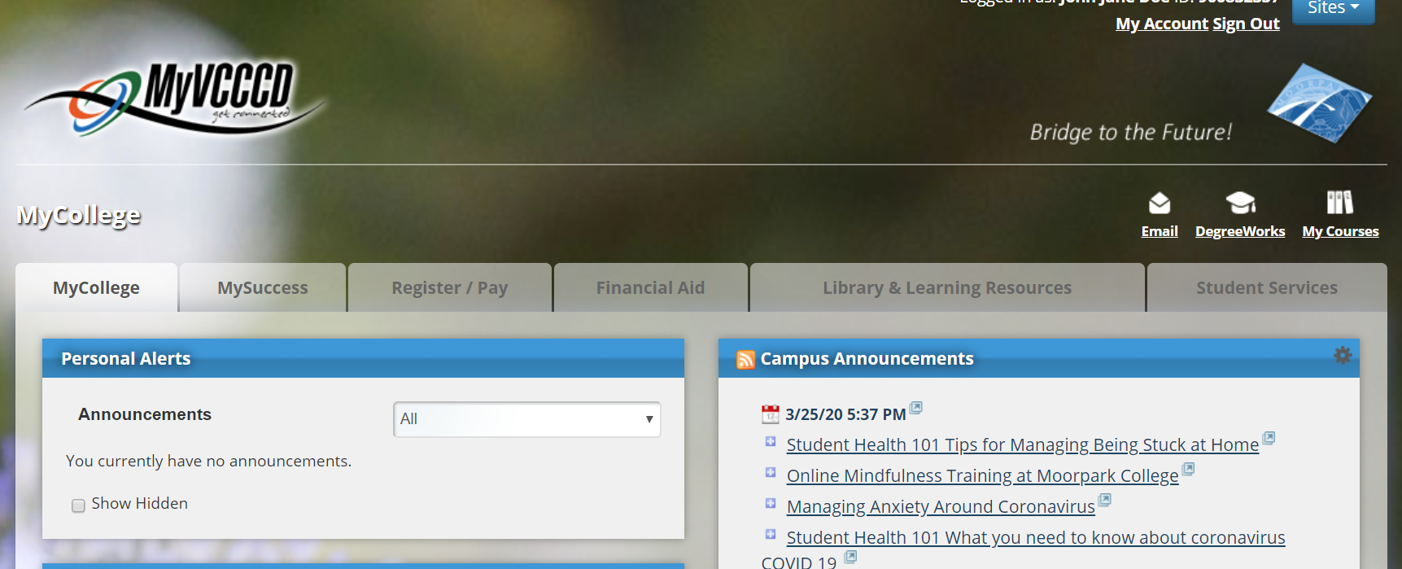
SUBMIT FORM
CLICK HERE
Once your form is completely signed, sign into Portal. Click the “Email” button and icon to setup your Moorpark College email account.

Slide 29
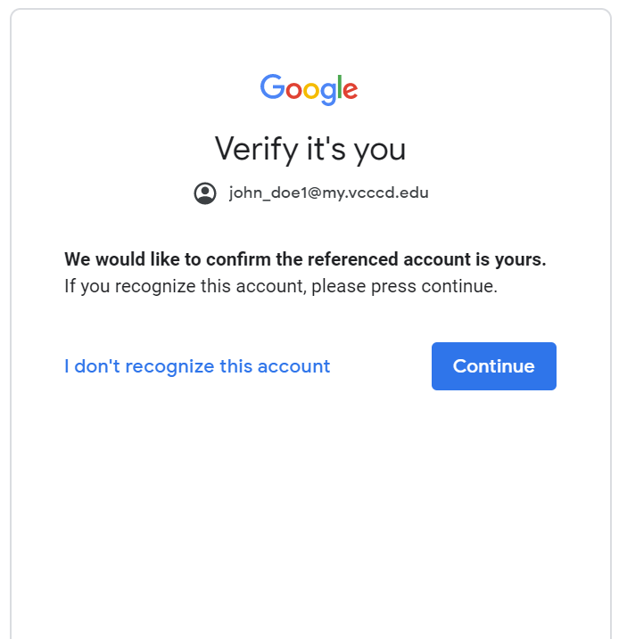
SUBMIT FORM
Press “Continue” and on the next page “Accept”.

Slide 30
THIS IS YOUR VCCCD EMAIL INBOX
SUBMIT FORM
Your email address is your MyVCCCD username (the one you wrote down earlier) followed by @my.vcccd.edu, so example would be firstname_lastname_number@my.vcccd.edu. Your password is the new password you created for your portal. You can link this inbox to your phone and/or download the free MyVCCCD Portal App.

Slide 31
TWO WAYS TO SUBMIT YOUR MOU FORM
SUBMIT FORM
Via Method #1: Email Submission
Via Method #2: Secure Form Submission Link
You only need to use one method (of your choice)

Slide 32
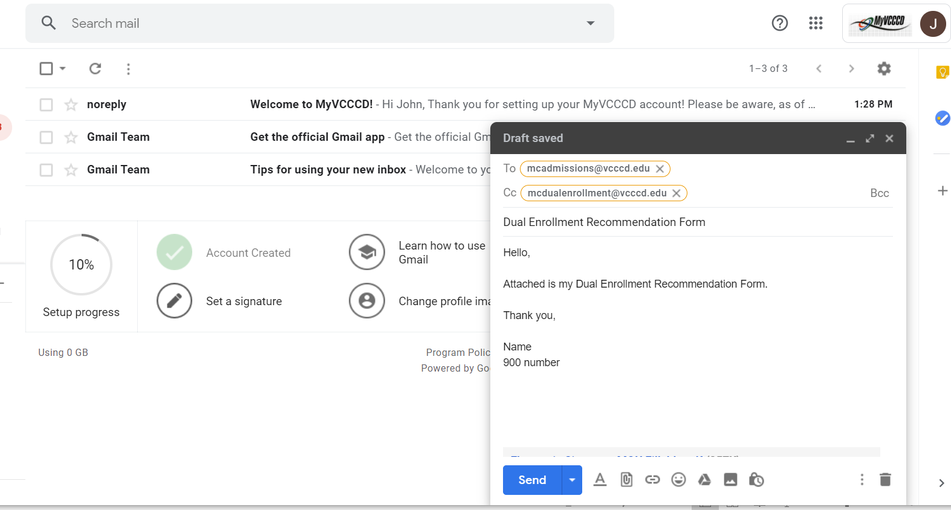
METHOD #1: EMAIL SUBMISSION
SUBMIT FORM
You can submit your Dual Enrollment Recommendation/MOU Form by emailing it to MCAdmissions@vcccd.edu from your VCCCD email address. Compose a new email exactly like the one above. Sign it with your name and ID number, and attach your completed form to the email. Press send.

Slide 33
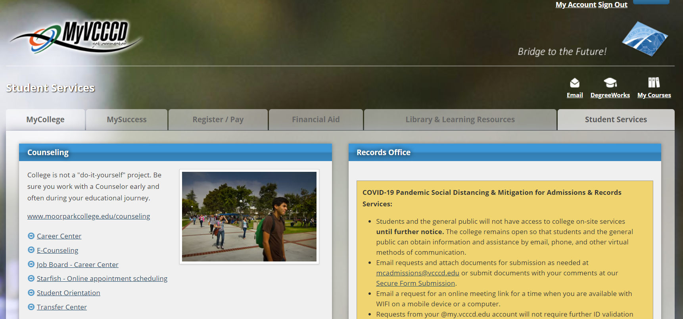
METHOD #2: SECURE FORM SUBMISSION
SUBMIT FORM
CLICK HERE
THEN CLICK HERE
Access your portal and click on the Student Services tab, then “Secure Form Submission.” Move to the next slide to see instructions to complete submission.

Slide 34
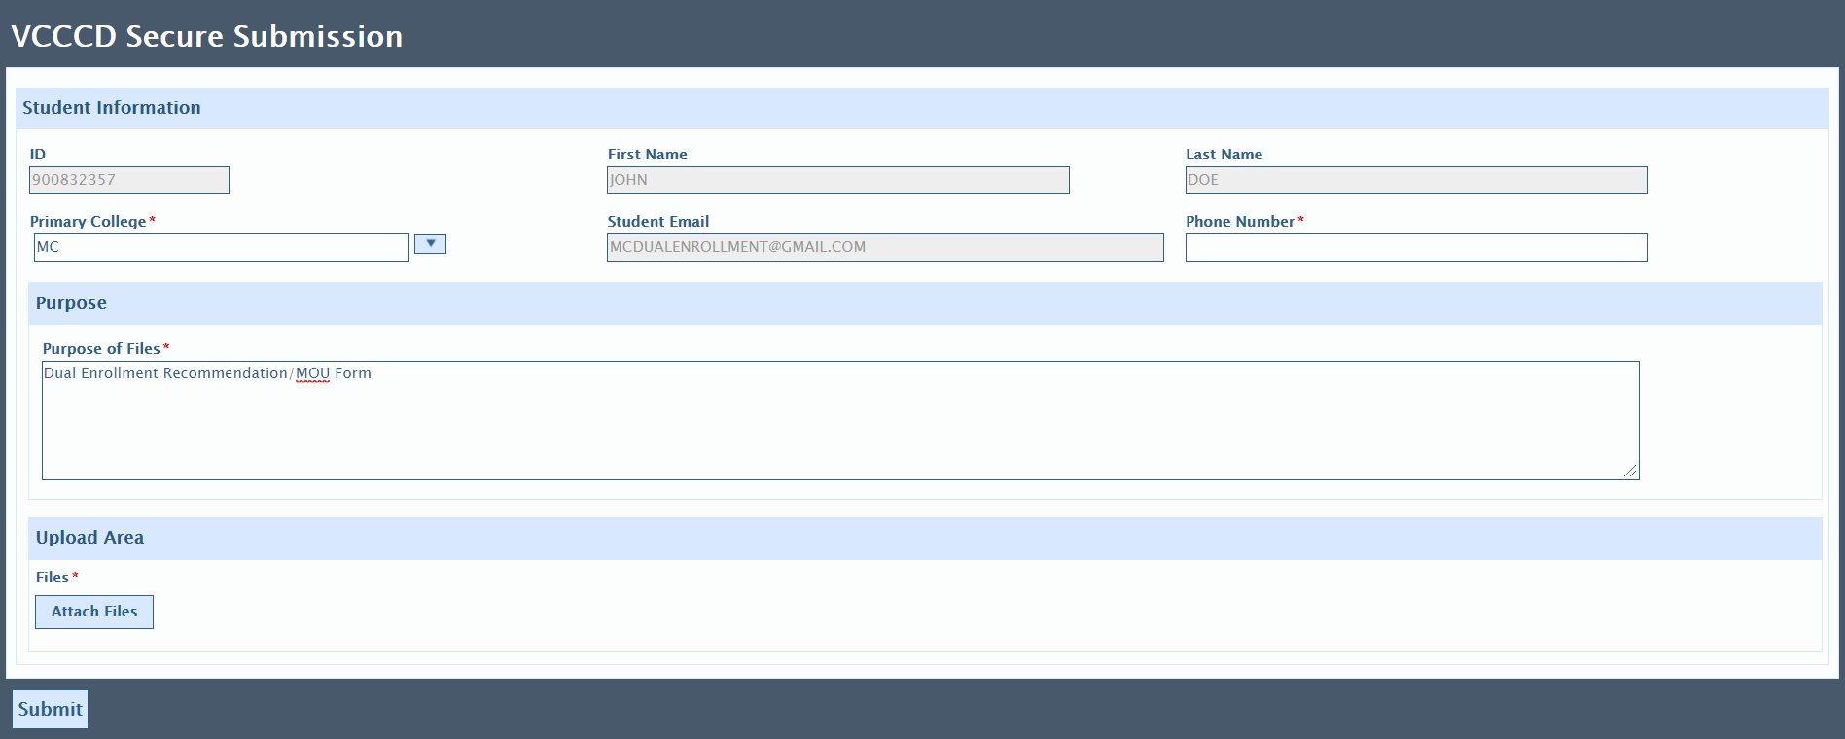
SUBMIT FORM
METHOD #2: SECURE FORM SUBMISSION (continued)
The information on the form is pre-filled, but make sure the correct “Primary College” is selected, and to include a phone number and the purpose of the file. You can type in “Dual Enrollment Recommendation/MOU Form” like written above. Attach the file by clicking “Attach Files” button. Once done uploading, click “Submit”.

Slide 35
STEP 4: REGISTER FOR COURSE
REGISTER

Slide 36
REGISTER
Once you submit your MOU form, either by email or through the Secure Form Submission link, you will be cleared to take the course(s) listed on the form.
You can then register for your course through the Register tab in your portal. Input CRN number (for Dual Enrollment classes offered on HS campus, ask your school official for the CRN number of your course) and then register for the class.
Watch video above or click this: Instructions in picture format (in case video above doesn’t play)

Slide 37
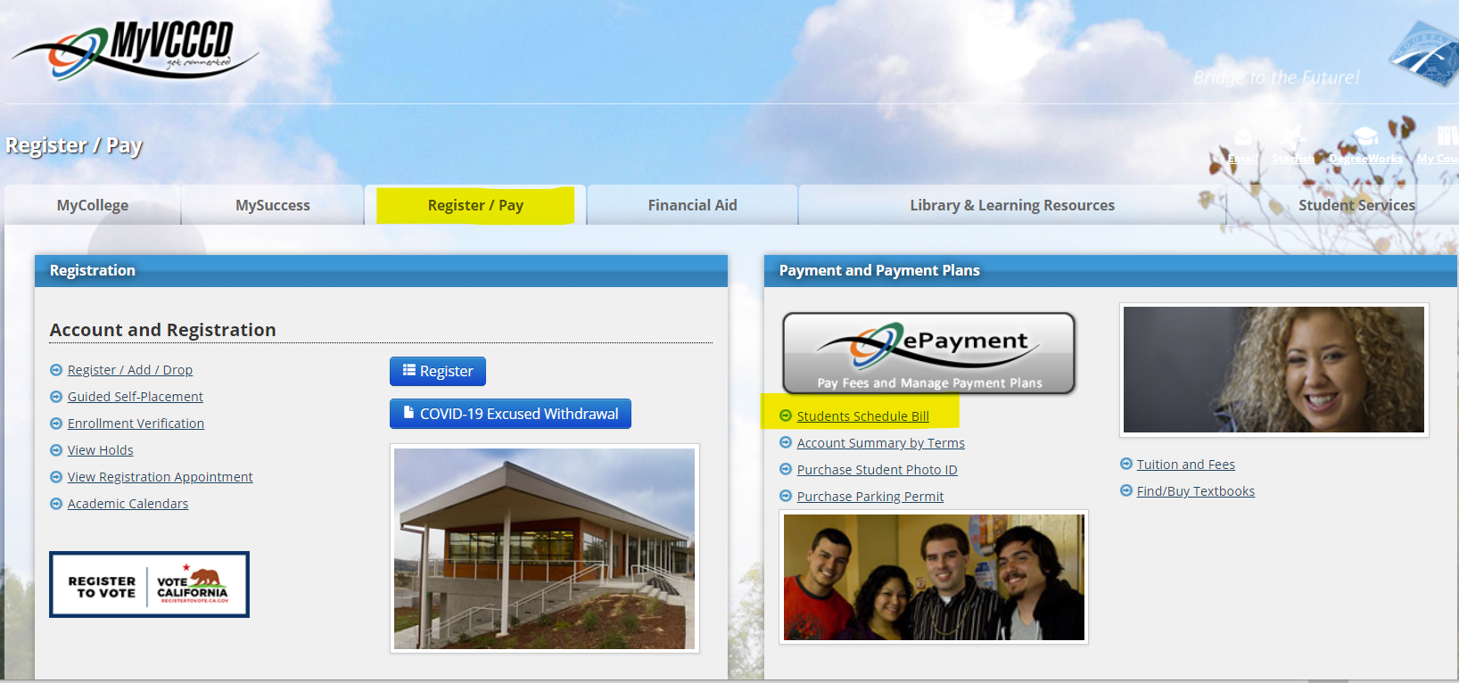
YOU DID IT!
Congratulations, you are now a college student and have registered for a college class!
To confirm that you have successfully enrolled in the class, you can access your Schedule Bill and make sure the class is listed there. If it is not, you are not registered for the class. See how to access your Schedule Bill below:
If your class has an online component, referred to as CANVAS, move to the next slide to learn how to access it.

Slide 38
ACCESSING CANVAS
CANVAS

Slide 39
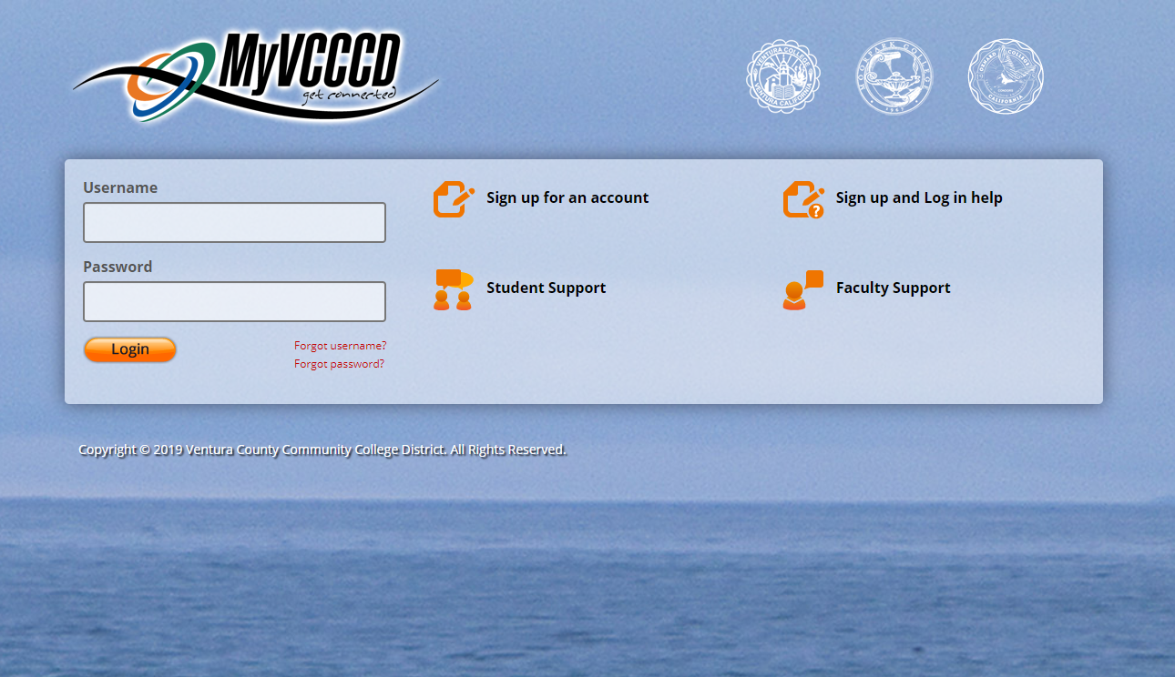
CANVAS
Login to your portal
Notes:
Start by logging in to your My VCCCD Portal.

Slide 40
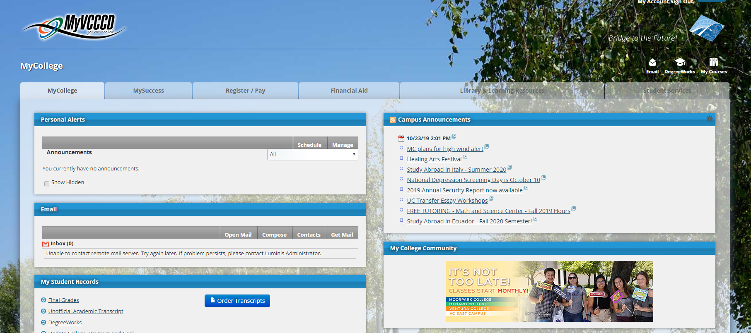
CANVAS
Click on “My Courses” in the top right corner
Notes:
Select the “My Courses” icon in the top left corner.

Slide 41
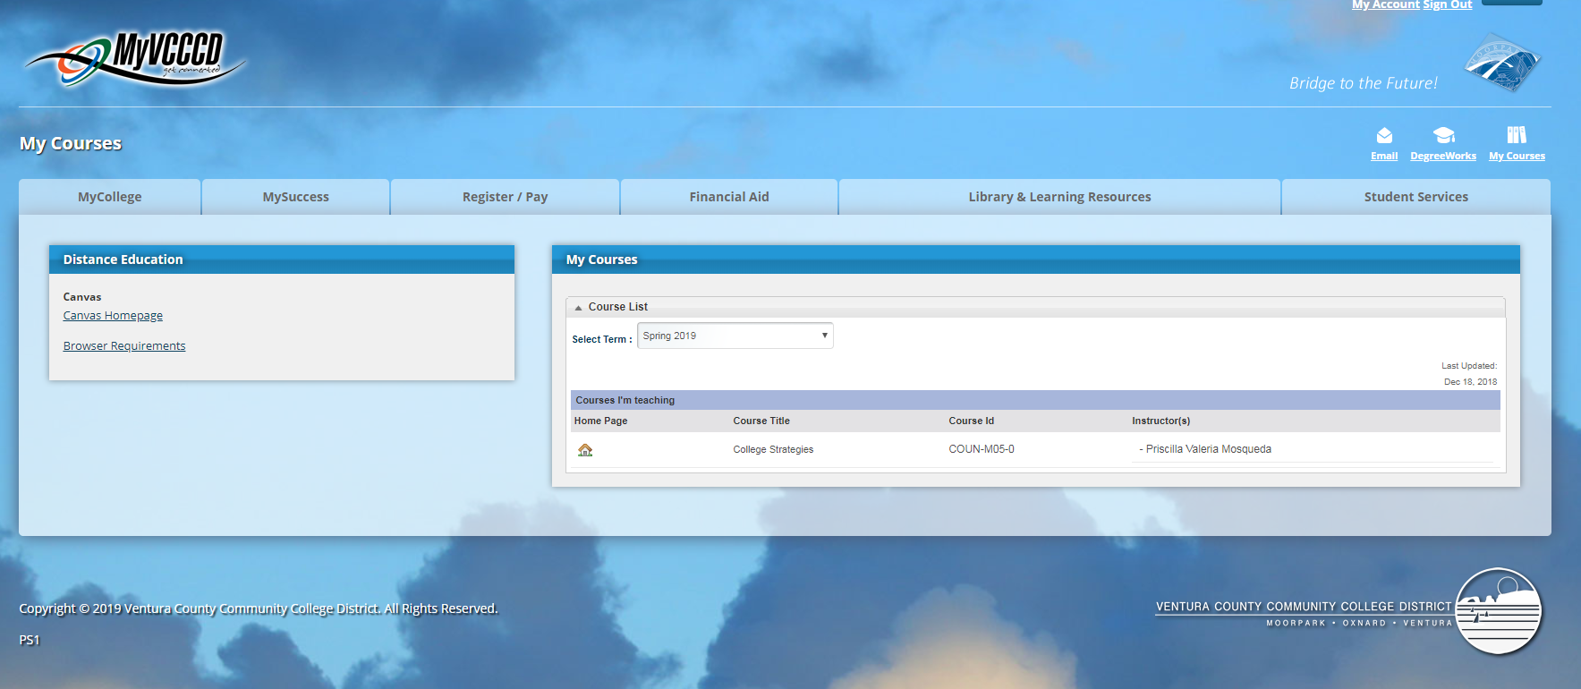
CANVAS
Then click on “Canvas Homepage”
Notes:
Select “Canvas Hoepage”

Slide 42
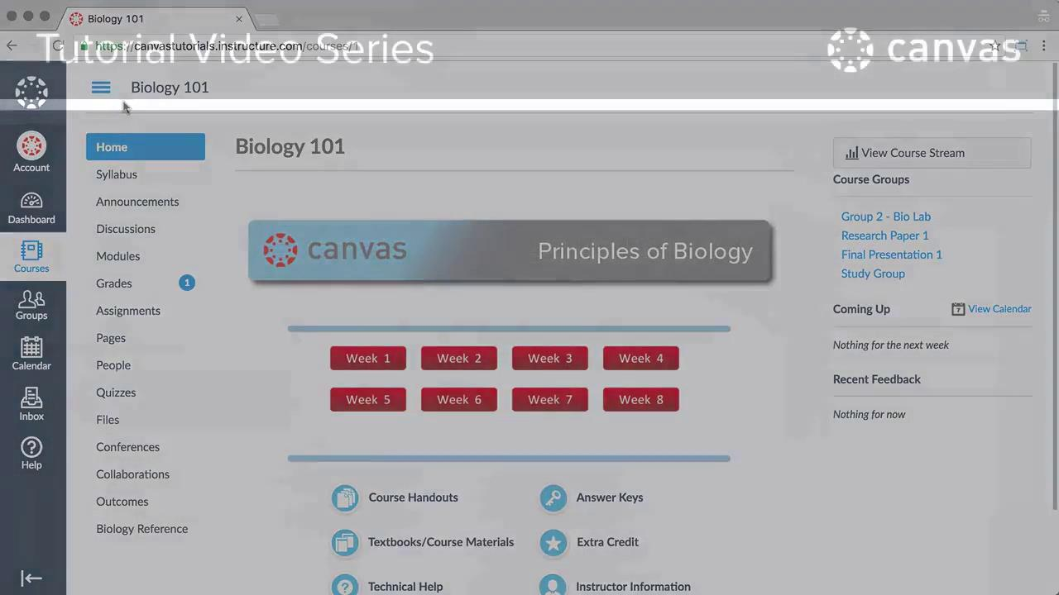
Notes:
Canvas Walk-through

