Slide 1
Mandatory Curriculum Committee training Fall 2020
Faculty Co-Chairs: Scarlet Relle, Letrisha Mai
Interim VPAA Co-Chair: Mary Rees
Curriculum Technician: Ana Barcenas
Notes:
SR

Slide 2
Why mandatory?
Colleges are required to train curriculum committees annually to be eligible for continued local approval certification.
Notes:
SR

Slide 3
Training Outcomes
Verification of membership
Review of roles and responsibilities​
Review of committee's goals for 2020-2021​
Review of curriculum approval processes
Review of curriculum submission timeline for 2020-2021​
Review of the law
Certification of Memo from Chancellor’s Office
Update on the blanket DE addendum
Update on key points from Curriculum Institute​
Questions
Notes:
SR

Slide 4
Verification of curriculum committee memberships
Co-chair, Interim Vice President of Academic Affairs: Mary Rees
Co-chairs, Faculty: Scarlet Relle, Letrisha Mai
Curriculum Technician: Ana Barcenas (non-voting)
Academic Data Specialist: Alan Courter (non-voting)
Academic Senate President: Erik Reese (ex officio)
AFT Representative: ______________ (non-voting)
Articulation Officer: Letrisha Mai
CTE Faculty Liaison: Christy Douglass
Dean: Carol Higashida
Dean: Howard Davis
Dean: Robert Cabral
Student Representative: _____________
Notes:
SR

Slide 5
Verification of curriculum committee memberships
Health Sciences: Olga Myshina
Kin., Athletics & HED: Adam Black
Library Resources: Danielle Kaprelian
Life Sciences: Beth Miller
Mathematics: Renee Butler
Media Arts and Communication Studies: Candice Larson
Physics, Astronomy & Engr.: Erik Reese
Social Science: Hugo Hernandez
Visual Arts: Clare Sadnik
World Languages: Perry Bennett
ACCESS/Learning Skills: Silva Arzunyan
(Jolie Herzig)
Behavioral Sciences: Veronique Boucquey
Business: Ruth Bennington (Josepha Baca)
Chemistry & Earth Sciences: Tiffany Pawluk
Child Development/Education: Shannon Coulter (Cynthia Sheaks-McGowan)
Counseling: Jodi Dickey
EATM: Cindy Wilson
English/ESL: Wade Bradford
Fine and Performing Arts: Robert Salas
Notes:
LM

Slide 6
Review of members' roles and responsibilities
A liaison between curriculum committee and respective division
Relay pertinent curriculum information from the committee to the division
Basic understanding of Title 5 requirements in regards to course and program development and review
Active participation in the curriculum review and approval process
Awareness of the curriculum submission timeline and how it can affect course and program offerings
Notes:
LM

Slide 7
curriculum committee goals for 2020-2021
Become proficient in using CourseLeaf
Continue implementation of COR/program review
Ensure curriculum compliance with Title 5 regulations
Review and if necessary update adopted ADTs for SB 1440 compliance
Continue implementation of CTE 2-year program review processes
Become familiar with course and program submission timeline, necessary documentation, and approval process
Become more efficient in communicating curricular information to departments and divisions
Review and if necessary update courses and propose new courses for C-ID
Adhere to the approval processes of noncredit curriculum in accordance with VCCCD policy and Title 5 regulations
Guide and support Culturally Responsive Curriculum
Explore options for granting Credit for Prior Learning (CPL)
Notes:
SR

Slide 8
Review of approval process:
new and substantive update to curriculum
Discipline faculty develop and submit curriculum
Local curriculum committee reviews and approves
May include separate tech review, DE review, requisite review, etc.
Local governing board approves – only new and substantively updated curriculum
Submit to Chancellor’s Office
Auto approval/chaptering for credit courses, local credit programs, CTE certificates
Review/approval for ADTs and noncredit short term vocational courses and programs
Once a Control Number is generated, curriculum can be:
Published in catalog, schedule of classes, etc.
Eligible for apportionment
Sent for external articulation and transfer agreements
Notes:
LM

Slide 9
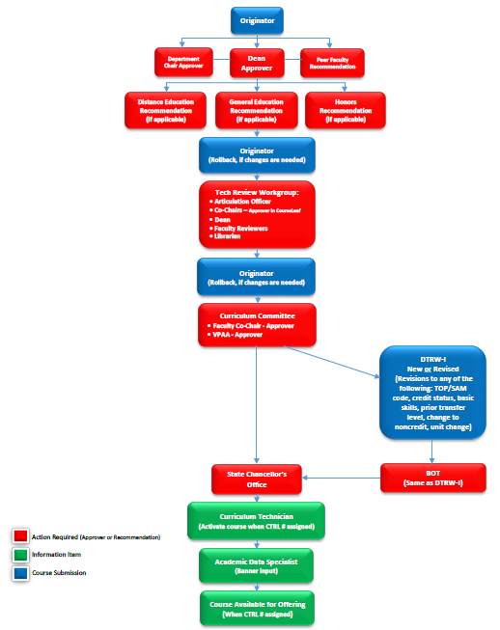
Review of approval process flowchart: courses
https://www.moorparkcollege.edu/sites/moorparkcollege/files/faculty-staff/committees/curriculum/Resources/course_flow_chart_5.2.pdf
Notes:
Ana

Slide 10
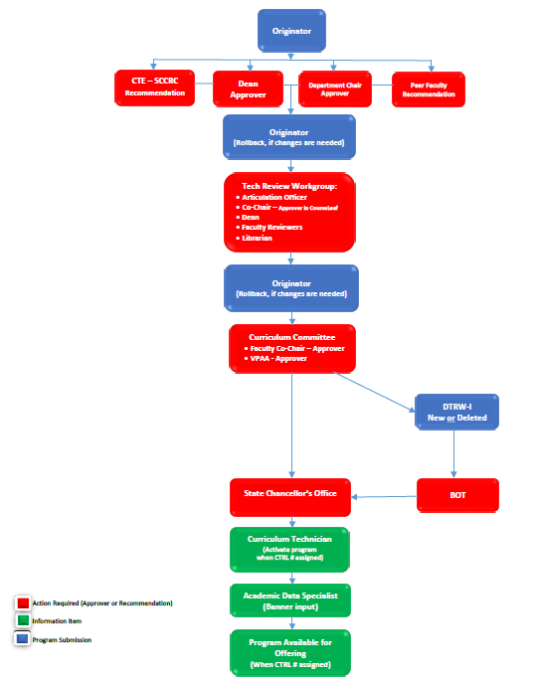
Review of approval process flowchart: programs
https://www.moorparkcollege.edu/sites/moorparkcollege/files/faculty-staff/committees/curriculum/Resources/program_flow_chart_4.4.pdf
Notes:
Ana

Slide 11
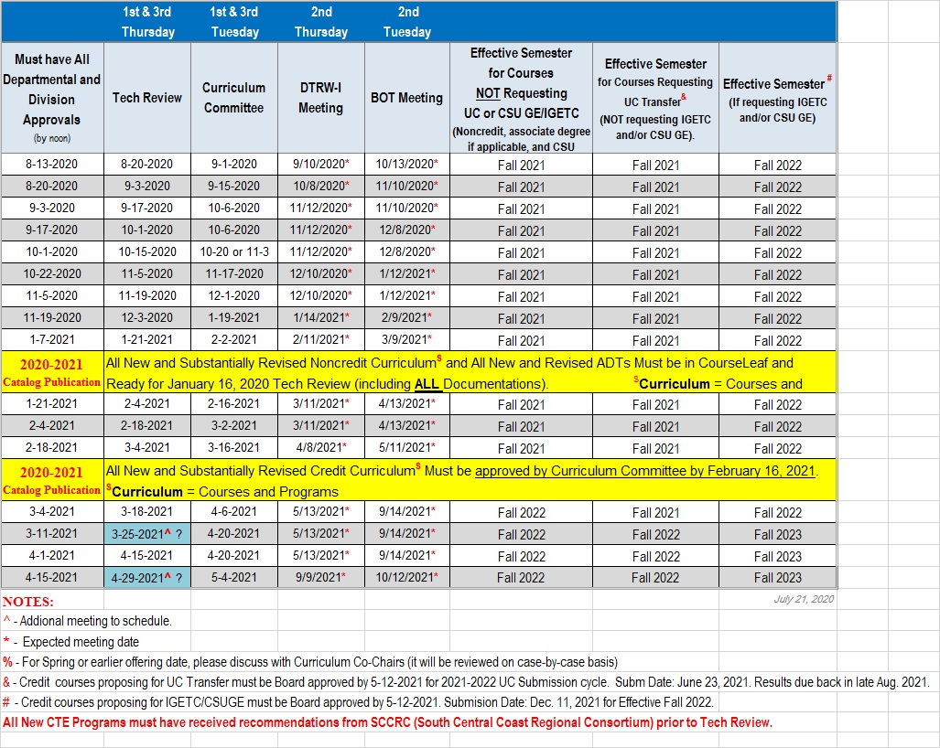
Curriculum submission timeline
Notes:
LM

Slide 12
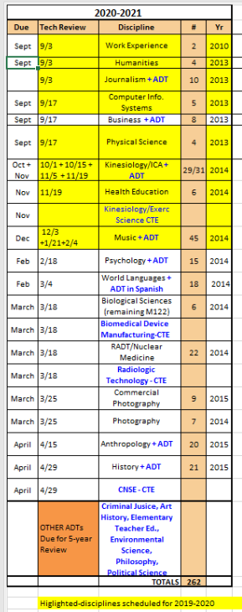
Disciplines up for review in 2020-2021
Notes:
LM

Slide 13
Review of the law
Notes:
SR

Slide 14
Layers of guidance
CA Education Code
Statute, determined by legislation
Title 5 (California Code of Regulations)
Title 5: Education
Division 6: California Community Colleges
Chapter 6: Curriculum and Instruction
Subchapter 1: Programs, Courses, and Classes
Division 5: California State University (CSU) system
Division 10: University of California (UC) system
Easy to search CA Code of Regulations at:
https://govt.westlaw.com/calregs/Browse/Home/California/CaliforniaCodeofRegulations
Notes:
SR

Slide 15
What is title 5?
Interprets the Ed Code into regulations, determined by Board of Governors (CCC)
Some Sections of the Law and Regulations in Title 5:
70902 Local Governing Board Approval of Curriculum
55000.5 Handbook; Monitoring and Review of Approved Courses and Programs
55002 Standards and Criteria for Courses
55002.5 Credit Hour
55003 Policies for Prerequisites, Corequisites and Advisories on Recommended Preparation
55040 District Policy for Course Repetition
and so on …..
Notes:
SR

Slide 16
What document interprets title 5? Pcah!
Required by Title 5, Section 55000.5
Program and Course Approval Handbook (PCAH)
Developed by Chancellor’s Office with CCC Curriculum Committee (5C)
Establishes specific guidelines for implementing Title 5
Provides criteria for program development and approval: Appropriateness to Mission, Need, Curriculum Standards, Adequate Resources, Compliance
Provides criteria needed for course development and approval: Course Outline of Record (COR)
Chancellor’s Office Guidelines
Further clarify implementation of Title 5 and emerging issues (e.g. AB 705)
Notes:
SR

Slide 17
Why do we follow title 5?
It’s the LAW!
To receive approval from the Chancellor’s Office for programs and courses
To receive apportionment from the State
Notes:
SR

Slide 18
Types of curriculum - credit
Courses
Degree-applicable
Non degree-applicable
Programs
Associate Degrees (AA, AS)
Associate Degrees for Transfer (AA-T, AS-T)
Certificates of Achievement
16 + units must be submitted to CO
8-<16 units may be submitted to CO
Locally Approved Proficiency Awards
<8 units; or 8 -<16 units CO approval not needed but it is encouraged to submit to the CO for tracking and counting of completion rate
Notes:
LM

Slide 19
Types of curriculum - noncredit
Courses
Noncredit: Courses must fit in one of 10 categories (see next slide) to be approved by Chancellor’s Office and receive apportionment
Vs. Not-for-credit/Community Services: Fee-supported class; apportionment is not claimed; locally approved. However, this is currently handled at the District Level.
Programs
Cert. of Completion/Competency (CDCP)
Adult High School Diploma
Noncredit Apprenticeship Program
Notes:
LM

Slide 20
Eligible Noncredit Categories EC § 84757; CCR title 5 § 58160
Noncredit Course Categories
ESL
Immigrant Education
Elementary and Secondary Basic Skills
Health and Safety
Substantial Disabilities
Parenting
Home Economics
Older Adults
Short-term Vocational
Workforce Preparation
Review and Approve by CO
Notes:
LM

Slide 21
Certification of Memo from Chancellor’s Office

Slide 22
signatories acknowledge and certify that:
Mandatory training for curriculum committees and responsible administrators regarding curriculum rules and regulations to ensure compliance ((CCR, §55002(a) (1)).
The college course outline of record has been approved by the District Governing Board;
The college/district has developed local policy, regulations, or procedures specifying the accepted relationship between contact hours, outside-of-class hours, and credit for calculating credit hours to ensure consistency in awarding units of credit;
Credit cooperative work experience plan has local board approval and is on file;
Credit and noncredit courses and programs that are submitted to the Chancellor’s Office Curriculum Inventory (COCI) system are accurate and compliant with California Education Code, California Code of Regulations, title 5, and the current CCCCO Program and Course Approval Handbook (PCAH);
Credit and noncredit programs have the required attachments in accordance with the current CCCCO PCAH;
Notes:
LM

Slide 23
Annual Certification Approval Policy
The Chancellor's Office (CO) requires each college to annually submit:
Annual Certification
Chief Executive Officer
Chief Instructional Officer
Academic Senate President, and
Curriculum Chair
Local Governing Board Policy
Policy must define the standards for credit hour calculations
Submit as PDF
Non-submission of the Annual Certification will result in a deactivation of “auto-approval” status
Notes:
LM

Slide 24
Local Approval Certification 2020-2021
The periodic review process will be ongoing
Information updates will be shared periodically
CO conducts periodic review, annotates findings, and notifies college of required revisions (discrepancies requiring corrective action)
College receives periodic review discrepancy notification from CO and has 60 days to respond to CO
College corrects discrepancies and submits amended curriculum via COCI
CO reviews corrected curriculum and notifies college
Non-punitive process; goal is to assist colleges in aligning curriculum with policy through technical assistance and guided support
*Note: does not include AD-Ts; see separate guidelines
Notes:
LM

Slide 25
Review process by CO for courses
Credit
All curriculum components will be reviewed
COCI proposal fields for data elements
Course outline of record meets standards in title 5, § 55002 (a) (b), and approved by the district governing board
Refer to PCAH 7, Part II, credit curriculum standards and criteria
Noncredit
All curriculum components will be reviewed
COCI proposal fields for data elements
Course outline of record meets standards in title 5, § 55002 (c), and approved by the district governing board
Refer to PCAH 7, Part III, noncredit curriculum standards and criteria
Notes:
SR

Slide 26
Review process by CO for Programs
Credit
Certificate of Achievement
All curriculum components will be reviewed
Narrative (with all components)
CORs for all courses
Appropriate supporting documentation for “Local” (non-CTE) certificates
Appropriate supporting documentation for CTE certificates
Refer to PCAH 7, Part II, Section 3 for credit certificate program standards and criteria
Noncredit
Certificate of Completion
Certificate of Competency
All curriculum components will be reviewed
Narrative (with all components)
CORs for all courses
Appropriate supporting documentation for short-term vocational (“CTE”) certificates
Refer to PCAH 7, Part III, Section 3 for noncredit program criteria and standards
Adult High School Diploma (AHSD) and apprenticeship see PCAH 7, Part III, Section 3 (pp. 135 – 137)
Notes:
SR

Slide 27
Review process by CO for AA/AS Degree
Compliance standards for associate degrees, as set forth in title 5, § 55063
All curriculum components will be reviewed
CORs for all courses
Narrative (with all components)
Appropriate supporting documentation for CTE associate degrees
Refer to PCAH 7, Part II, Section 3 for all credit degree program standards and criteria
CTE AA/AS Degrees: PCAH 7, pp. 79 - 84
Local AA/AS Degrees (non-CTE): PCAH 7, pp. 84 – 89
Notes:
SR

Slide 28
Review process by CO for ADT
The ADT program is a partnership between the CCC and CSU system
ADTs must be compliant with applicable legislation, title 5, and PCAH requirements
Periodic review will include compliance of:
Current TMC (Transfer Model Curriculum)
All CORs attached
All courses included on TMC meet the requirement listed on the TMC C-ID Articulation, AAM (Articulation Agreement by Major), BCT (CSU Baccalaureate Level Course List by Dept.) or GECC (CSU GE Certification Course List by Area)
Review of Narratives including the catalog descriptions with random checks against the current school catalog to confirm they are the same
For ADTs, colleges will be asked to respond to revision request within 60 days. Once the college responds they will have an additional 6 months from the response date to make necessary revisions for approval.
If a colleges does not meet the corrective parameters described above, the ADT program will be deactivated in COCI.
Notes:
LM

Slide 29
adt list up for review: 2020-2021
Criminal Justice (Administration of Justice)
Anthropology
Art History
Business Administration
Elementary Teacher Education
Environmental Science
7. History
8. Journalism
9. Kinesiology
10. Music
11. Philosophy
12. Political Science
13. Spanish
Notes:
LM

Slide 30
Update on the blanket “De addendum”
Course offerings for summer and fall 2020 have been updated with faculty selected appropriate DE Addendum
Workflow on some of these courses have been started:
Chair and Dean approval
Courses will be on the Curriculum Committee Consent agenda on first come, first served basis
Will bypass Tech Review
Notes:
SR

Slide 31
Key Points from 2020 Curriculum Institute
Culturally responsive curriculum
4 workgroups
Credit for Prior Learning
will be a district wide project
Notes:
SR

Slide 32
Chancellor’s Office Guidance
Guidelines for Title 5 Regulations Section 55003 Policies for Prerequisites, Corequisites, and Advisories on Recommended Preparation (March 2011)
California Community Colleges Guidelines for Community Services Offering (September 20120)
Guidelines for Required Instructional Materials in the California Community Colleges (January 2013)
Credit Course Repetition Guidelines (November 2013)
Division of Educational Services and Support: Curriculum and Instruction
Chancellor’s Office COVID-19 Resources – includes Executive Orders and Guidance

Slide 33
Other documents
TOP-CIP Crosswalk (June 2020)
California Education Code
CCR, Title 5
Program and Course Approval Handbook - “PCAH”, 7th Edition
Taxonomy of Programs “TOP Code” Manual, 6th Edition
The Course Outline of Record: A Curriculum Reference Guide Revisited (ASCCC, 2017)

