Slide 1
Academic Freedom and Diverse Knowledges:
The Role and Application of Critical Race Theory in the Classroom
Manuel J. Vélez, ASCCC South Representative
Juan Arzola, ASCCC At-Large Representative

Slide 2
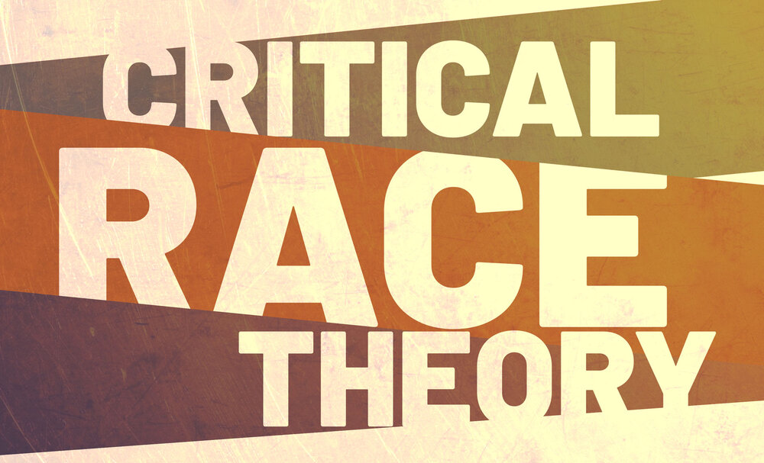
Introduction to Session
During this session we’ll discuss the following:
The controversy around CRT and the importance of addressing it
Dispelling the myths around CRT
Defining CRT as well as its main tenets
CRT and Academic Freedom
CRT in the classroom

Slide 3
Community Expectations/Norms
ASCCC Executive Committee Norms
A = Authenticity
C = Collegiality
HD = Honor and Dedication
SPP = Self Awareness, Presence, and Patience
Notes:
Juan Arzola

Slide 4
The Importance of Addressing CRT Counter-narrative
Aligns with the social justice oriented mission of California Community Colleges
Develop and improve critical thinking skills
Progress never stops
Notes:
Juan Arzola

Slide 5
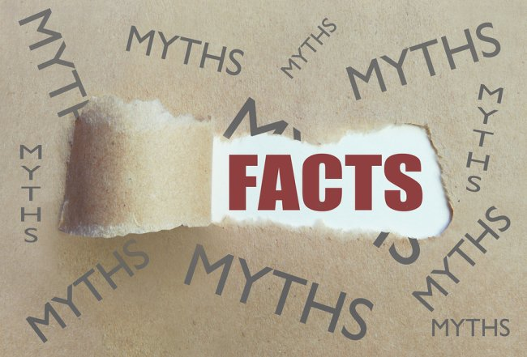
Dispelling the Myths Around
Critical Race Theory

Slide 6
Myth #1: CRT teaches students that all white people are racist
Myth
White students are traumatized by teachers who blame them for society’s racism
CRT causes divisiveness among racial/ethnic groups and pits whites against blacks
CRT is itself racist because it tries to categorize all white people as the same
Truth
CRT is not a part of most academic standards and curriculums, especially at the elementary and secondary school level
Systemic Racism, a foundational tenet of CRT, moves the focus away from individuals and explores racism within structures and elements of society
Through counterstories Critical Race theorists work to dispel stereotypes that cause divisiveness and to create common understanding among different groups

Slide 7
Myth #2: CRT is Marxist and has a political agenda
Myth
Several opponents of CRT, especially politicians have claimed that CRT is “identity-based marxism”.
They point to its foundations in Critical Legal Studies which includes the theories of Karl Marx, among others as proof
They also claim that CRT scholars are pushing an extreme “left-wing” agenda upon the country
Truths
While the foundations of CRT are in Critical Legal Studies, it also moved away from those foundations as it began to place more focus on systemic racism
Marxist theories inform many different academic theoretical lenses. In fact, Critical Theory specifically moves away from Marxism as a political party and towards a theoretical framework
As an academic theoretical framework, CRT has no connection to legislation (outside of analyzing it)
(I have no idea what “identity-based marxism” even is)

Slide 8
Myth #3: CRT removes “American Exceptionalism” from the curriculum
Myth
CRT encourages students to “hate” the U.S.
CRT emphasizes the failures of the country rather than its successes
CRT de-emphasizes and even denies the country’s founding principles
Because of CRT, students can no longer pledge allegiance to the flag or express patriotic ideas
Truth
As a theoretical framework CRT focuses on critical analyses based on objective and empirical data
“American Exceptionalism” in itself is a myth based on eurocentric notions.
As a social-justice framework CRT attempts to ensure that concepts such as life and liberty are truly accessible to all

Slide 9
Myth #4: CRT is really just History
Myths
Opponents of CRT claim that it emphasizes the negative moments in American history and highlights the historical racism of whites
They also claim that CRT attempts to replace the history of white americans with that of Black Americans
Proponents argue that CRT is really just history that has been hidden by white society
This focus has led to school boards passing laws that regulate the teaching of history in schools
Truth
CRT as a theoretical framework is inter-disciplinary and is used by many different disciplines aside from history
CRT’s framework allows scholars to analyze contemporary society and culture in all of its aspects to reveal how racism impacts them
Within the discipline of History, CRT can be used to analyze any historical era, whether it is black, white, or any other ethnicity

Slide 10
Group Discussion #1: Dispelling Myths and Engaging in Real Dialogue
After having heard about some of the common myths associated with Critical Race Theory, engage in a discussion with your breakout group by addressing each of the following points:
How familiar are you with the myths we’ve identified here? Through what medium or in what context have you heard them?
Is there debate over CRT at your college or among your faculty? What are the most common arguments made in that context?
How familiar are you with CRT today? What concerns, if any, do you have over CRT?
While we encourage robust dialogue, we also urge you to please keep your comments civil and objective.

Slide 11
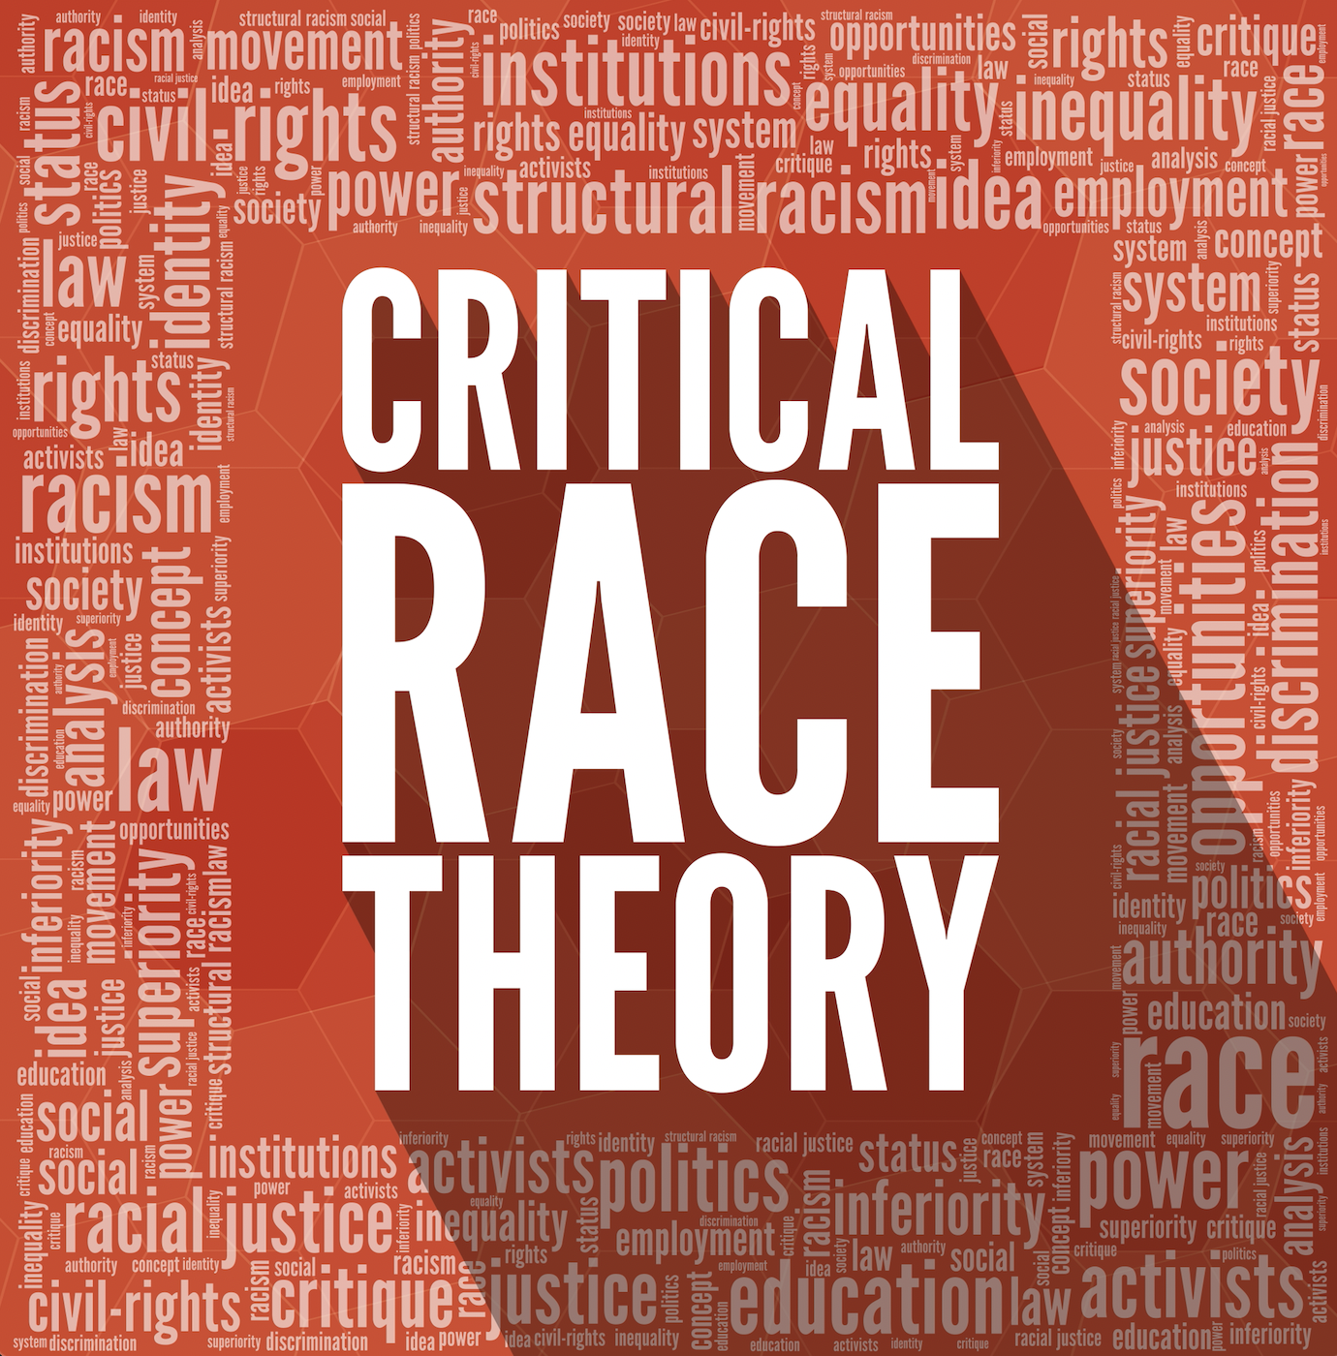
Defining Critical Race Theory
Critical Race Theory is a relatively recent form of academic thought that attempts to analyze race relations in a broader context than the traditional civil rights approach
Critical Race theorists look closely at daily interactions to reveal the racial component within them. They argue that race and racism play a significant role in how members within a society interact with each other and how institutions within that society continue to rely on racialized views
CRT is a reaction to and contradiction of the “Colorblind” approach to racism, which attempts to address racism by erasing the question of race from any discussions.
CRT strives to not only analyze racism but to expose and redress it.

Slide 12
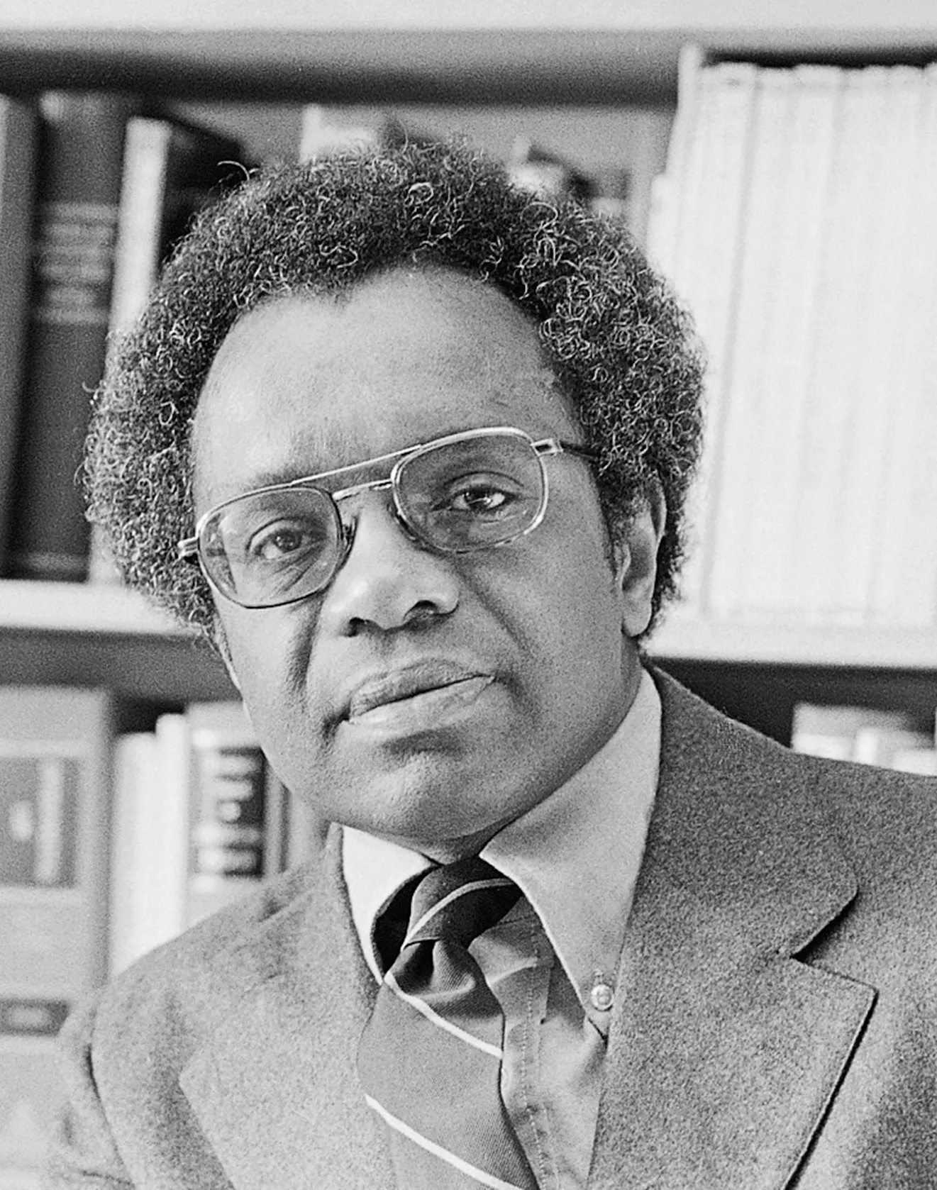
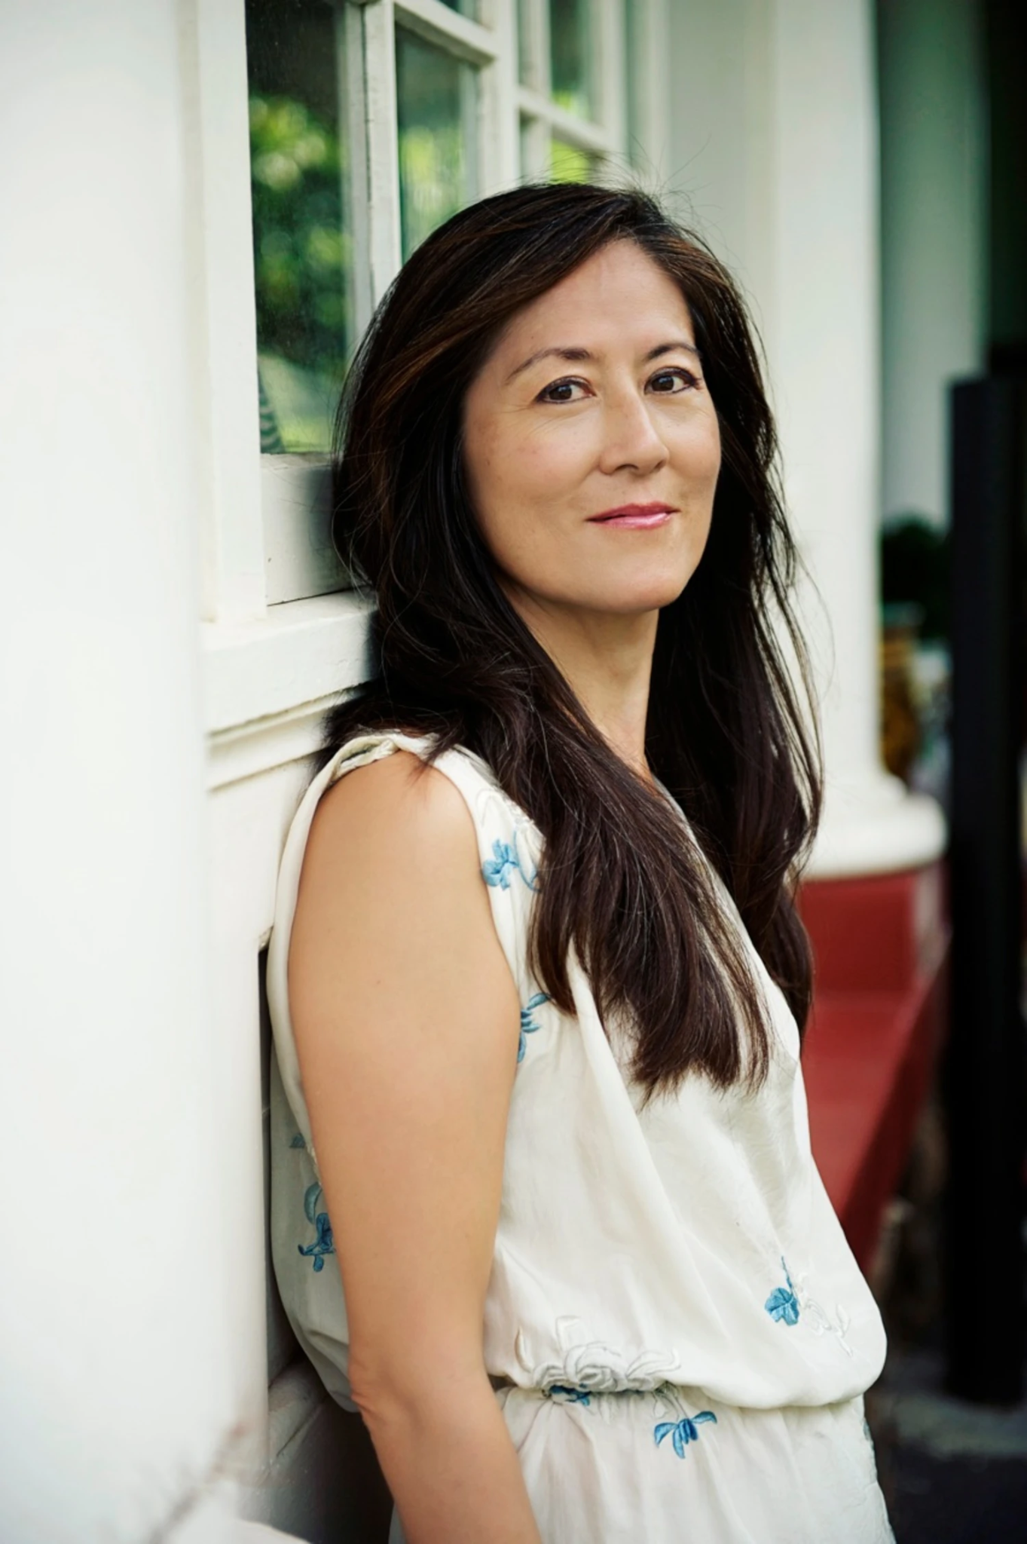
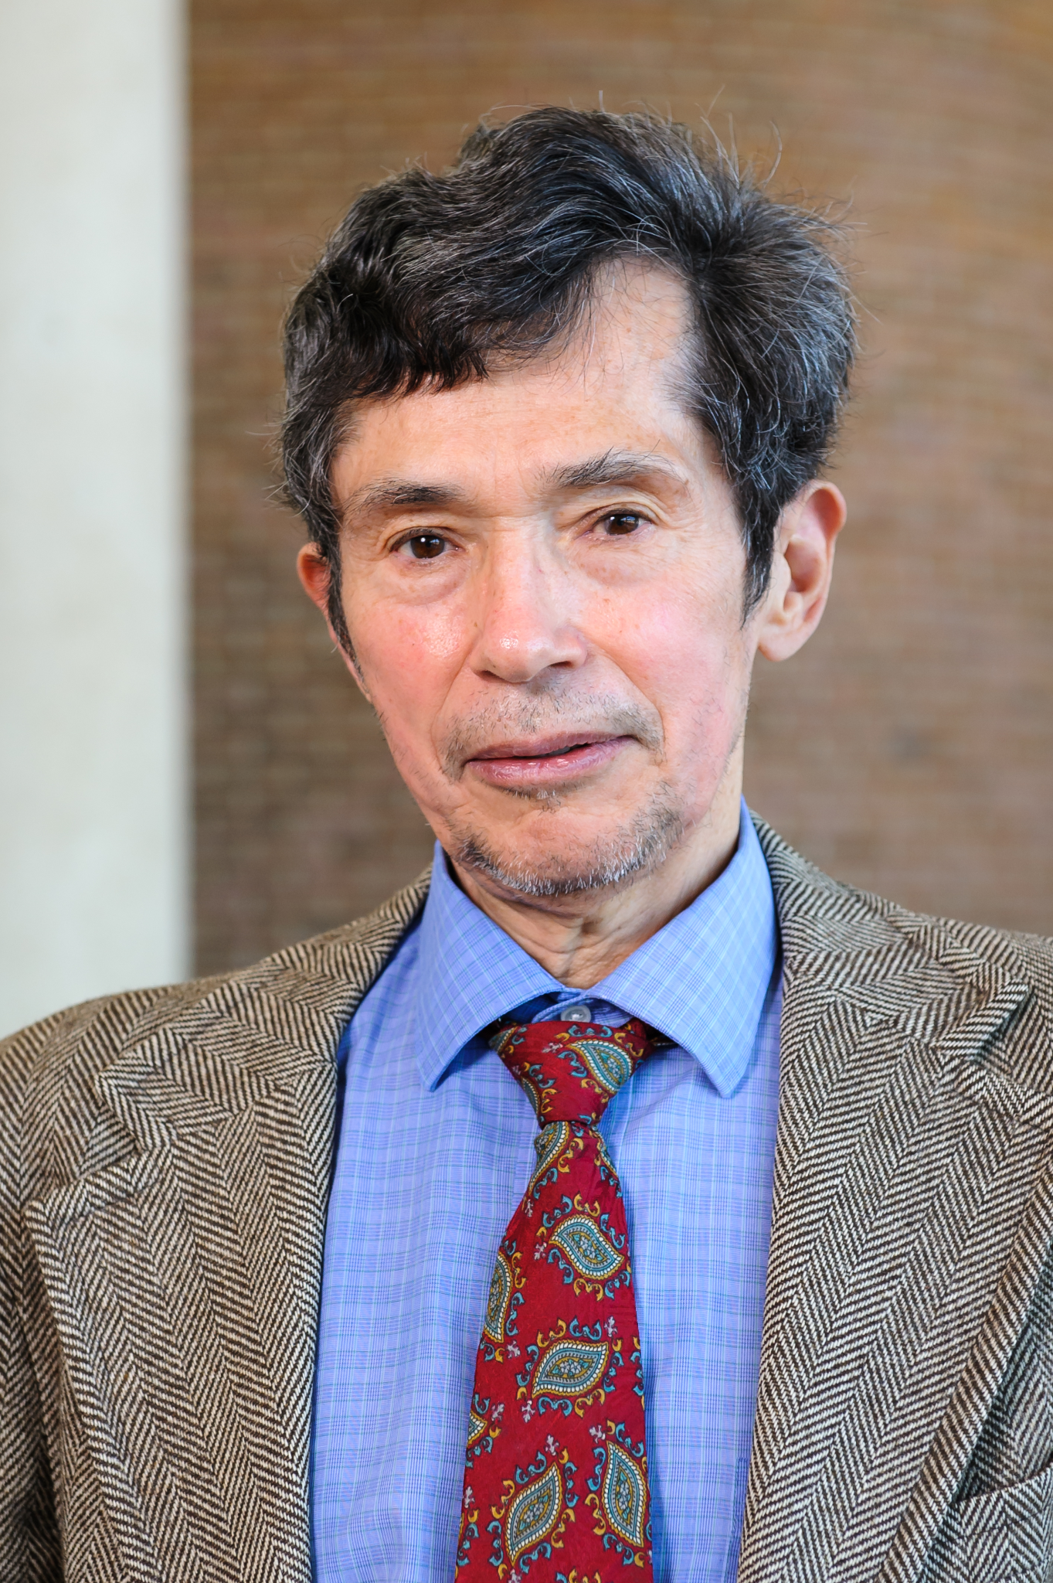
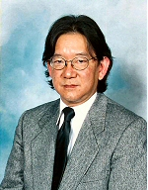
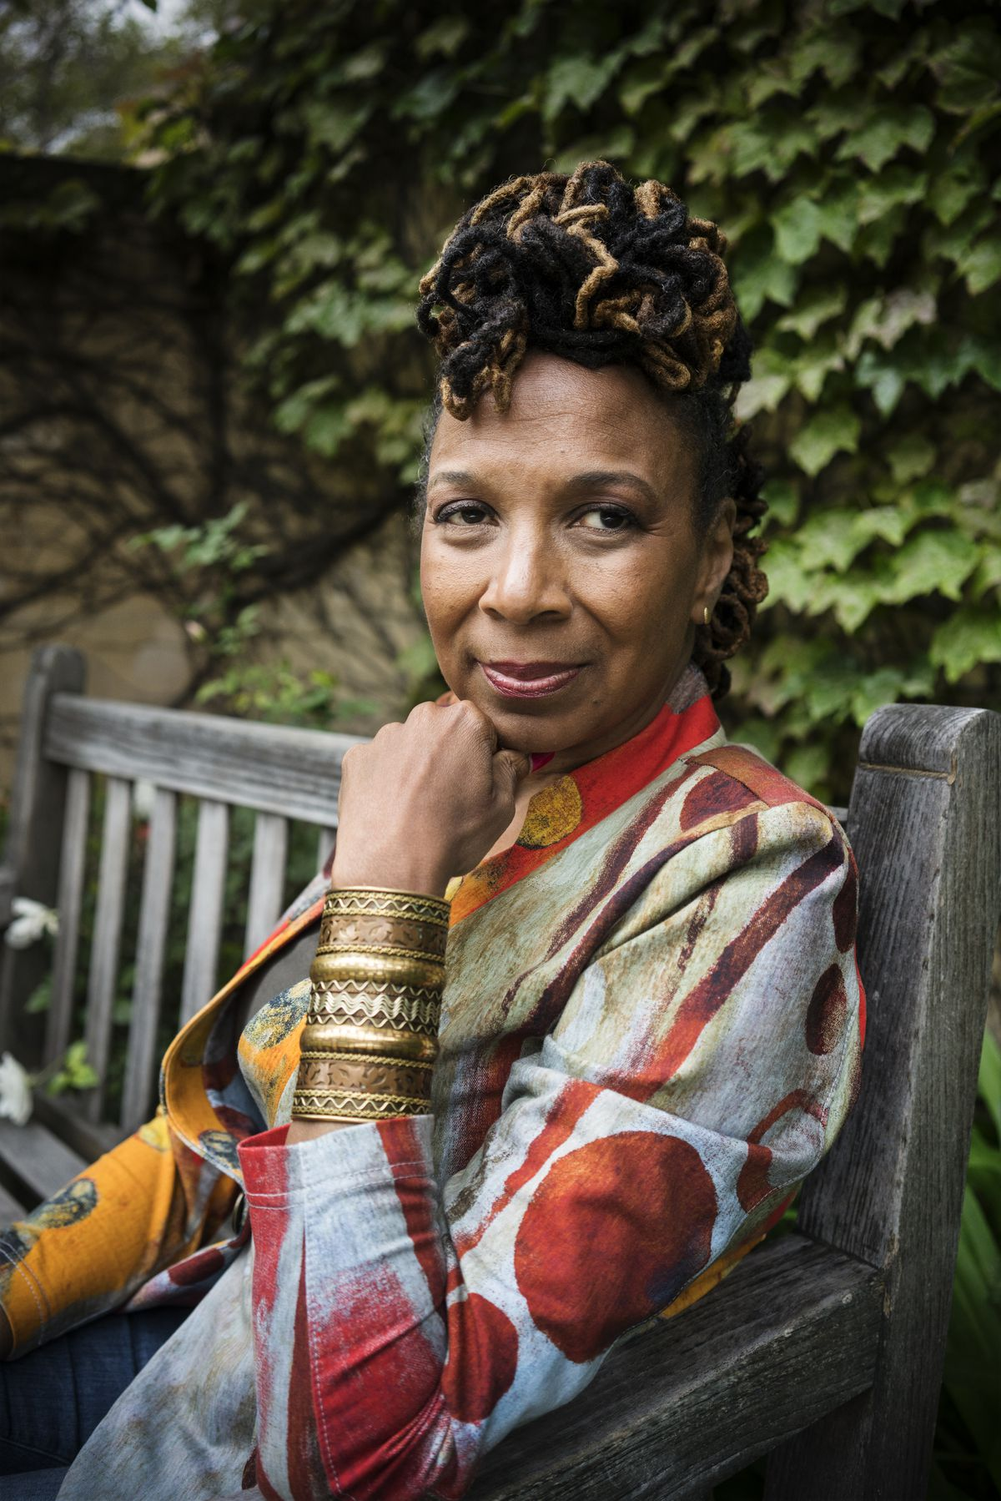
A brief history of Critical Race Theory
Said to have been established in the 1970s in the United States as an extension of Critical Legal Studies
Founders of CRT were Black, Latinx, and Asian-American scholars who had become concerned with the law’s inability to address racism in the U.S.
Derrick Bell, a legal professor who applied theories of race to legal interpretation, is credited as one of the founders.
Though it began in Critical Legal Studies, CRT was quickly applied in various other disciplines
Other early CRT scholars include Richard Delgado, Mari Matsuda, Tara Yosso, Kimberle Crenshaw and Neil Gotanda

Slide 13
Features of Critical Race Theory
CRT strives to advance a social justice framework
CRT attempts to reach a “wider public” by fusing or even moving beyond traditional academic frameworks.
CRT uses “counterstories” to challenge tacitly accepted notions of race and the racial experience
CRT tends to be organized around core questions that reach into several disciplines and that require multiple strategies. In this way, it is “interdisciplinary”.

Slide 14
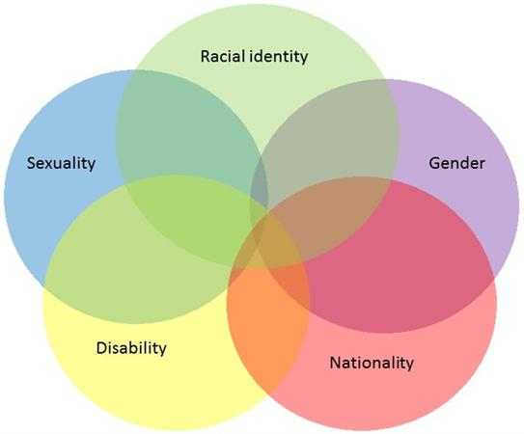
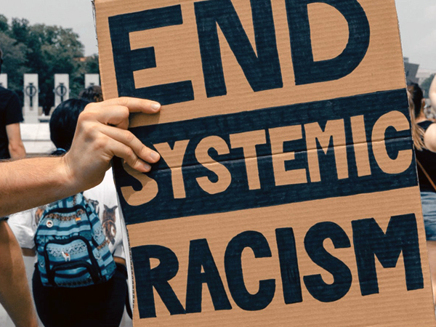
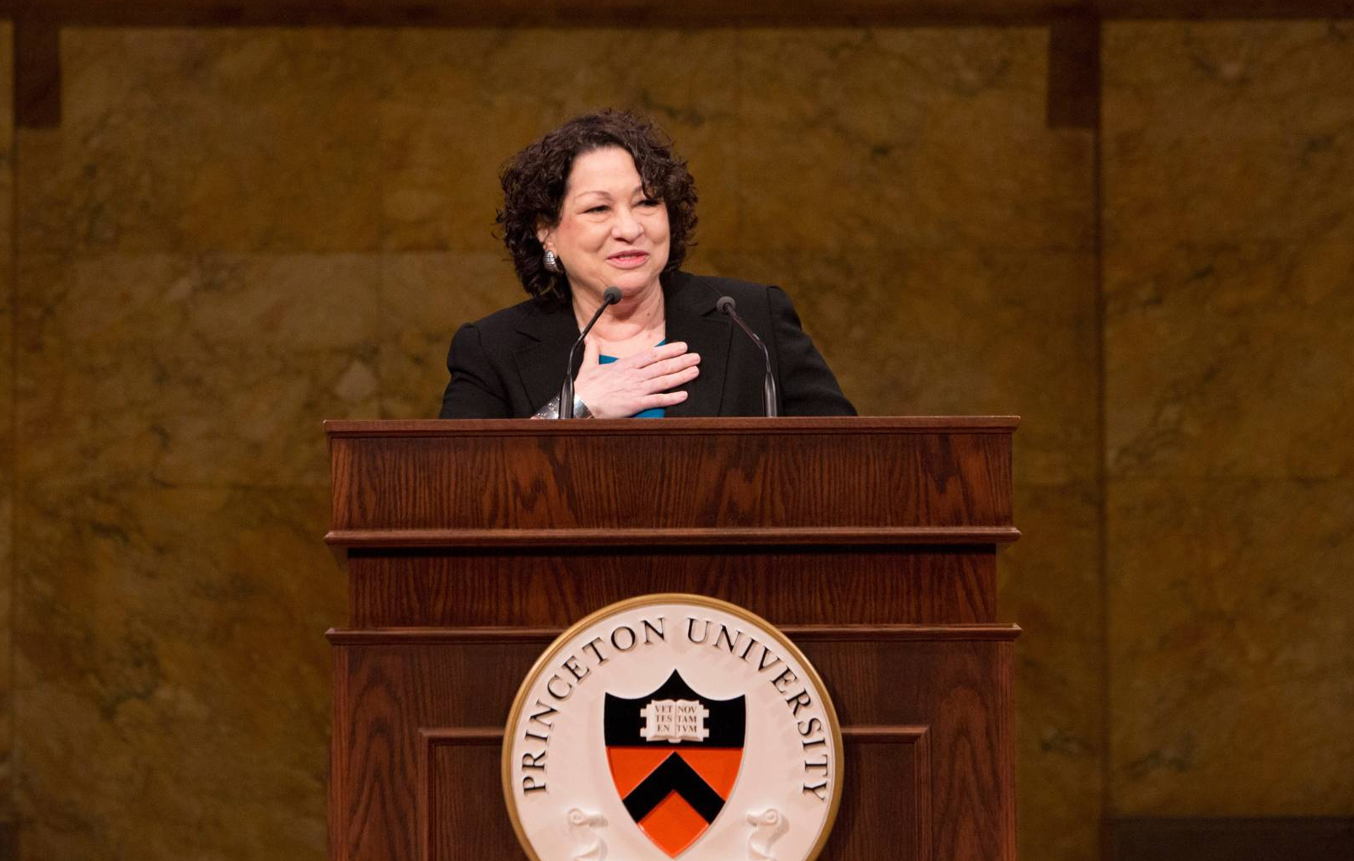
The Tenets of Critical Race Theory
Racism is ordinary, not aberrational (Systemic Racism)
Racism advances the interests of working-class and upper-class whites. Most gains made by communities of color usually coincide with white “self-interest” (Interest Convergence)
Race is a product of social thought and relations (Social Construction)
Dominant society racializes different groups at different times in response to shifting needs (Differential Racialization)
Everyone has potentially conflicting, overlapping identities, loyalties, and allegiances (Intersectionality)
Because of their more direct history with oppression and racism, Latinx, Asian-American, African-American writers and thinkers may be better able to communicate matters related to race (The Voice-of-Color Thesis)

Slide 15
CRT and Academic Freedom
KEY to Truth-telling;
IMPORTANT to achieving the social justice oriented mission of community colleges;
NECESSARY for learning, teaching, and leading as a Faculty
Notes:
Juan Arzola

Slide 16
CRT in the classroom
Notes:
Juan Arzola

Slide 17
Developing Lesson Plans through a CRT framework
Examine Course Outline of Record (COR);
Augment mainstream topics (Knowledge) with scholarship produced by Scholars of Color (Voices-of-Color Theory in Practice);
Introduce diverse knowledge through culturally responsive/relevant teaching (i.e., empower students to activate their own knowledge or connect Diverse Knowledge to the student’s experiences on campus or their community)
Notes:
Juan Arzola

Slide 18
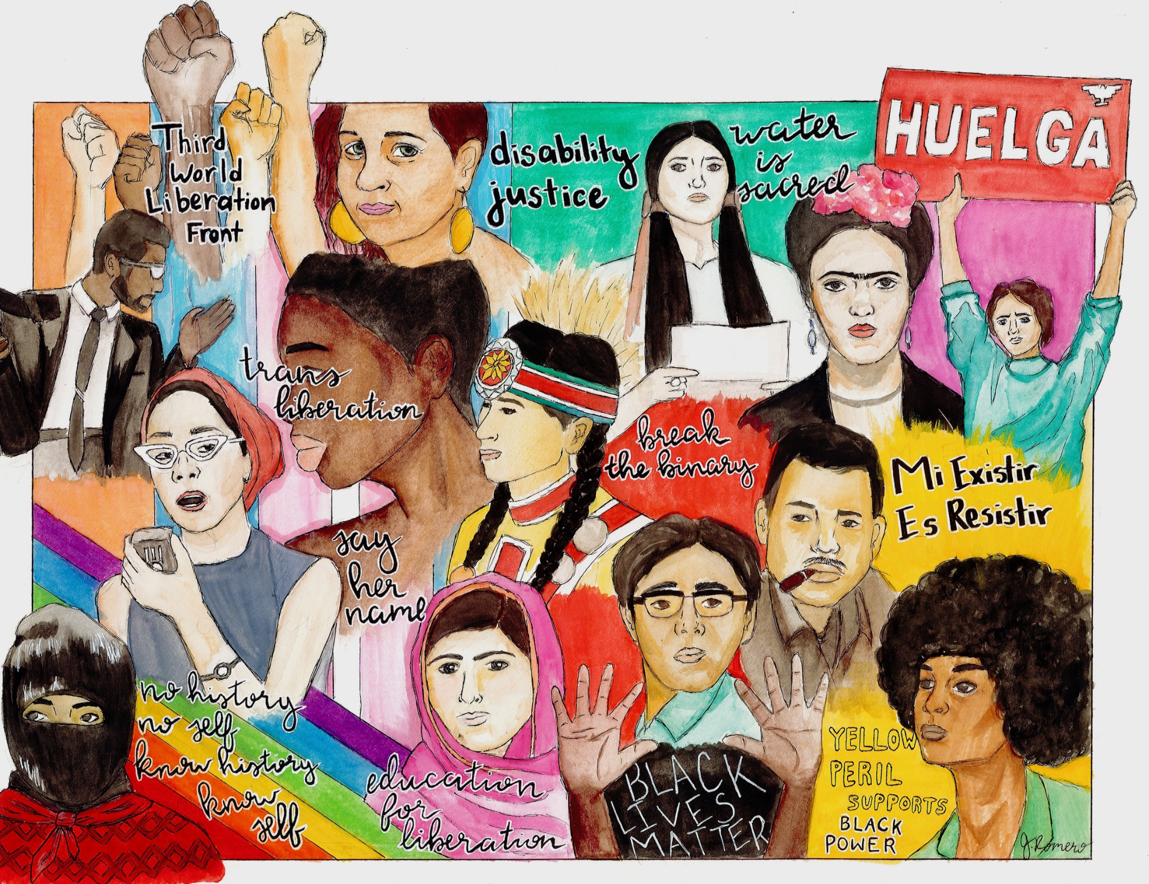
CRT as a Disciplinary Framework
Because of their shared focus on the lived experiences of communities of color, CRT has become a foundational framework for Ethnic Studies disciplines
While CRT isn’t derived directly from Ethnic Studies its establishment coincides with the establishment of Ethnic Studies and has certainly helped in its evolution
CRT is also utilized throughout various disciplines where more courses are being taught through a racial/social justice lens
In these cases, CRT functions to analyze subjects away from the eurocentric methods that have dominated academia

Slide 19
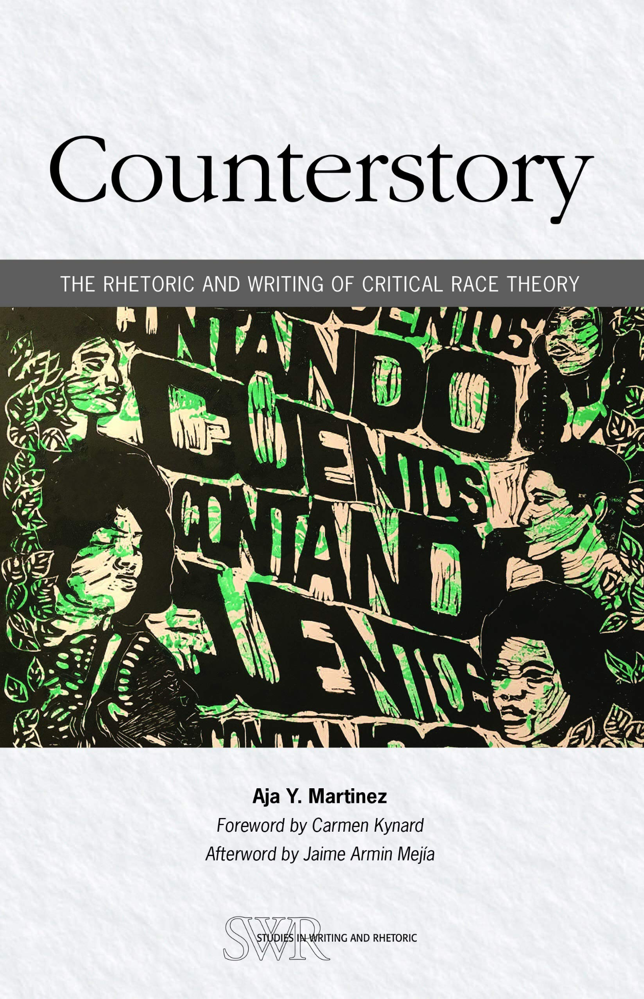
The Critical Race Counterstory
Critical race counterstorytelling is a method of recounting the experiences and perspectives of racially and socially marginalized people
Counterstories can serve to expose and identify types of racial discrimination and reveal that these types impact entire communities
They reflect on the lived experiences of people of color to raise critical consciousness
They work to counter “majoritorian narratives” which emphasize racial experiences through the lens of those with racial and social privilege
Rather than trying to prove racism exists, counterstories attempts to document it persistence from those impacted most by it

Slide 20
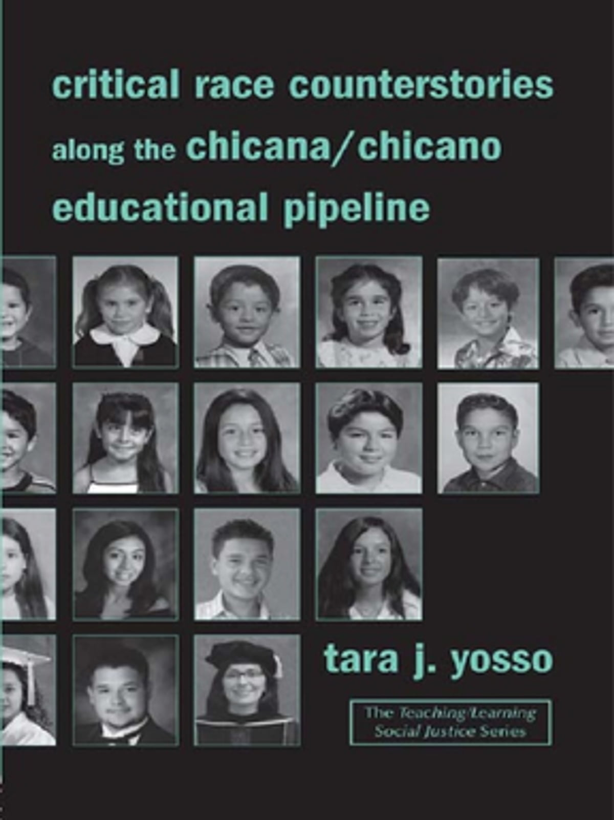
Critical Race Counterstorytelling
Counterstories draw on academic research, social science and humanities literature, and judicial records as a means of dispelling racial stereotypes
They often blend narrative with data and at times, elements of fiction in order to challenge majoritorian narratives
CRT scholars utilize three types of counterstories: Autobiographical, Biographical, and Composite
Conterstorytelling can strengthen traditions of social, political, and cultural survival and resistance

Slide 21
Addressing confrontations/disruptions against CRT in the classroom
Develop a community relationship in the classroom;
Acknowledge that culturally responsive/relevant teaching strategies may not apply to all students, but focusing on importance of diversity of thought and knowledge is;
Notes:
Juan Arzola

Slide 22
References
Yosso, Tarra Critical Race Counterstories Along the Chicana/Chicano Educational Pipeline
Delgado, Richard and Jean Stefancic Critical Race Theory: An Introduction
Hindman, Jade “Myths and Misunderstandings Fuel Controversy Over Critical Race Theory” KPBS Midday Edition 20 September 2021

