Slide 1
Legislation, Regulation, and Guidance…and Academic Freedom? Thursday, April 7 | 2:45-4:00
Notes:
Ginni

Slide 2
Description
Over the last dozen years, adopted initiatives and mandates resulting from legislation sponsored by special interest groups, regulation approved by the Board of Governors, goals in the Vision for Success, and guidance from the California Community Colleges Chancellor’s Office have had a significant impact on curriculum and instruction in the California community colleges. Nationally, statutes are also threatening academic freedom. Join the Legislative and Advocacy Committee for an overview of these initiatives and mandates, followed by a candid discussion on issues ranging from student agency in course-taking, educational pathway options, Ethnic Studies education, to most critically, academic freedom.
Notes:
Ginni

Slide 3
Presenters
Virginia “Ginni” May, ASCCC Vice President, Chair
Ric Epps, Imperial Valley College
María Figueroa, MiraCosta College
Jeffrey Hernandez, East Los Angeles College
Karla Kirk, ASCCC North Representative
June Yang, Grossmont College
Notes:
Ginni and all

Slide 4
Overview
12 Years of Initiatives Impacting Curriculum
State of Academic Freedom
Discussion
Ethnic Studies education
Academic freedom
Educational pathway options
Student agency in course-taking
Notes:
Ginni

Slide 5
12 Years of Initiatives Impacting Curriculum
2010 | 2012 | 2013 | 2017 | 2018 | 2019 | 2021 | 2022*
SB 1440 (Padilla) Transfer Associate Degree for Transfer (ADT) | SB 1456 (Lowenthal) Seymour-Campbell Student Success Act of 2012 Education Plans and Success Metrics | SB 440 (Padilla) Student Transfer Achievement Reform Act ADT if a Local Associate Degree | AB 705 (Irwin) Seymour-Campbell Student Success Act of 2012: Matriculation: assessment Vision for Success System Goals Guided Pathways | Budget Act: Student Centered Funding Formula (SCFF) | Budget Act: Cradle-to-Career Data System | AB 928 (Berman) Student Transfer Achievement Reform Act of 2021 AB 1111 (Berman) Common Course Numbering | AB 1705 (Irwin) Seymour-Campbell Student Success Act of 2012 All students (with limited exceptions) in transfer-level English and math *proposed
Notes:
Ginni
Some supported, some not supported – essential to be forward thinking, collegial,

Slide 6
The State of Academic Freedom
California Education Code
Nothing yet…
SR 45
California Code of Regulations Title 5 §51023
Boards must adopt policy on academic freedom
American Association of University Professors (AAUP)
1940 Statement
Accrediting Commission of Community and Junior Colleges (ACCJC)
Eligibility Requirement 13, 20
Standard I.C.7
Catalog Requirements
Threats…
Missouri HB 952
Arizona HB 2281
More…
Notes:
Ginni
Just the facts – discussion to follow

Slide 7
Discussion…
TOPICS…
Ethnic Studies education
Academic freedom
Educational pathway options
Student agency in course-taking

Slide 8
Ethnic Studies Education
What is Ethnic Studies and what is NOT Ethnic Studies?
AB 1460 (Weber)
Title 5 Regulations
AB 1964 (Fong)
Let’s take a look…
Notes:
María – open explain how this came forward in a non-reactionary fashion
Karla – bullets 1, 2
Ginni – bullet 3
Jeffrey – bullet 4
Problems when trying to address problems through legislation

Slide 9
To Be or Not to Be… Ethnic Studies
Notes:
Karla

Slide 10
History of Ethnic Studies as Discipline
San Francisco State University supported the first Black Studies Program in 1968, which became a department a year later. Between 1969 and 1973, roughly 600 programs and departments were created. Currently, approximately 200 Black Studies disciplines throughout the United States strive to discover the African roots of humanity, challenge the status quo and critique social policy.
The Black Studies programs at California Community Colleges like Merritt College and Fresno City College was established in 1969 in response to student protests on campus demanding inclusion of the African American perspective at institutions of higher learning and for institutional support of equality on campuses around the country. At the same time Chicano Studies programs were being established at UCLA. over the next decade.
Ethnic/Cultural Studies programs developed and were integrated into the field of Social Sciences in the 1990s, with many Ethnic Studies alum earning degrees in Sociology, Psychology, English and Counseling, among other fields.
Notes:
Karla

Slide 11
Defining Ethnic Studies Discipline
Ethnic Studies is the umbrella terms for the department/area that houses programs/courses in the four following disciplines:
African American/Africana/Black Studies
American Indian/Native American Studies
Asian American Studies
Chicano/a/Latino/Mexican American Studies
“Ethnic Studies” can also represent an introduction to comparative Ethnic Studies courses that is centered on the four above disciplines.
Notes:
Karla

Slide 12
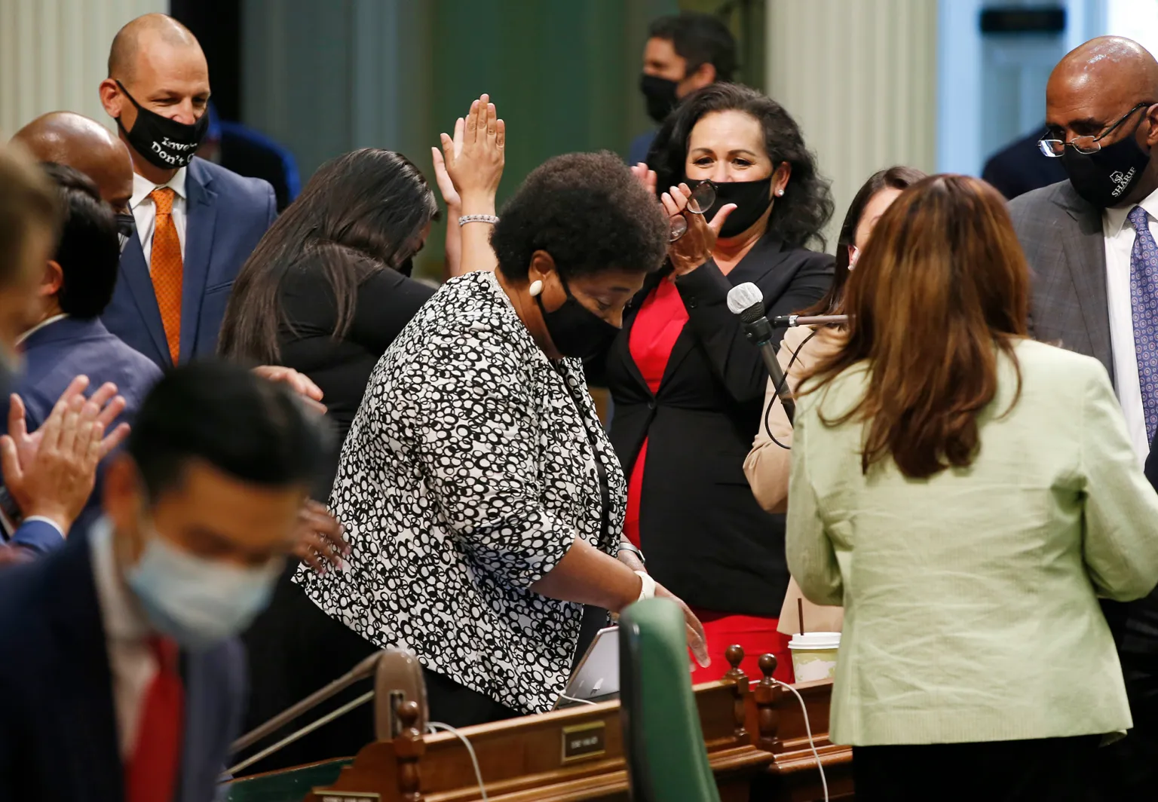
AB 1460: Racial Justice in Higher Education
Authored by Assembly member Dr. Shirley Weber and sponsored by the California Faculty Association (CFA), AB 1460 (Weber, 2020) reflects 50 years of student, faculty, and community advocacy for curriculum reflective of and pedagogy responsive to the diverse demographic of the state. California senators cited that education scholarship has well documented the positive academic outcomes for both students of color and white students who enroll in Ethnic Studies courses, as well as the need for the California State University (CSU)—the largest and among the most diverse four-year postsecondary systems in the United States—to equip students with the critical thinking and social skill sets to empathetically serve California and the nation at large. Senators also made a clear distinction between Ethnic Studies and diversity or multicultural studies, in which the former facilitates explicit conversations on race.
California State Senate Passes AB 1460 | Assembly Democratic Caucus (asmdc.org)
Notes:
Karla

Slide 13
Academic Freedom
SR 45 (Min)
Loss of Academic Freedom threatens Inclusion, Diversity, Equity, Anti-racisim, and Accessibility (IDEAA) Work
Arizona HB 2281
California Code of Regulations Title 5 §51023
ASCCC Positions:
S22 6.02 Support of SR 45 (Min, 2021) as of March 17, 2022 – for debate and consideration by delegates on Saturday, April 9, 2022
Resolution F20 06.02 F20 Legislative and System Support for Academic Freedom
ASCCC Paper: Protecting the Future of Academic Freedom During a Time of Significant Change, Adopted Fall 2020
Academic Freedom and Equity, Rostrum article November 2020
1940 AAUP Statement
AAUP and AFT partnership
Notes:
June, Jeffrey
Process: in Title 5 and ACCJC, but not Ed Code; Legislature looking for support first, hopefully a bill next year and sponsored by FACCC
What is academic freedom? Why is it important? What threats are there?

Slide 14
Educational Pathway Options
AB 928 (Berman, 2021); AB 705 (Irwin, 2017); AB 1705 (Irwin, 2022)
Opportunities…
Cost and Time savings: reduction in General Education courses for transfer
Places students on a clearly defined pathway, ADT
Exploration to consider needed additional units for full STEM prep in ADT pathway
Students can begin in transfer-level course work
Notes:
Ric, June, Ginni
Basic requirements – see slides from fall 2022
ICAS is hoping to have recommendations come out in May/June 2022 for vetting in fall 2022
What options are available to students and how do students know about them?

Slide 15
Educational Pathway Options
AB 928 (Berman, 2021); AB 705 (Irwin, 2017); AB 1705 (Irwin, 2022)
Challenges…
CSU/UC Capacity for more transfer students
CSU determines ADT similarity | no guarantee for transfer to UC with ADT
Pathways for English as a Second Language students
Choice to seek remedial education threatened
Other pathway options such as local associate degree, certificates, CTE
All students to enroll in transfer-level English and mathematics (with limited exceptions)
Limited options for place-bound students
Notes:
Ric, June
Basic requirements – see slides from fall 2022
ICAS is hoping to have recommendations come out in May/June 2022 for vetting in fall 2022
What options are available to students and how do students know about them?
- What am I seeing??? Pro’s and Con’s (6) Impact academic freedom? Other Pathway options

Slide 16
Student Agency in Course-Taking
AB 1705 (Irwin, 2022) provisions
Place and enroll new and continuing HS grads in transfer level English and Math
Placement primarily based on HS transcripts; multiple measures shall increase, not lower
Pre-transfer level restrictions
Must increase probability of completing transfer level within 1 year
For non-transfer program, pre-transfer math only if transfer level will not meet requirement
Concurrent support limits
Must increase probability of completing transfer level within 1 year
May offer or require only for no Algebra II, <2.5 HS GPA, or no transcripts
Proposed ASCCC Plenary Resolutions
3.04 S22 Expand Methods of Data Collection and Analysis to Fully Measure the Successes and Challenges of AB 705
6.03 S22 Upholding the California Community College Mission - Seeking Amendments To AB 1705 (Irwin, As Of March 15, 2022)
6.04 S22 Students’ Right to Choose to Take a Pre-transfer Level English or Mathematics Course
6.05 S22 Regarding Chancellor’s Office Student Enrollment Data In AB1705 (Irwin, 2022)
Notes:
Jeffrey

Slide 17
Resources
ASCCC Legislative and Advocacy Committee: https://www.asccc.org/directory/legislative-and-advocacy-committee
ASCCC Legislative Updates: https://www.asccc.org/legislative-updates
FACCC/ASCCC Legislative and Advocacy Webinars: https://asccc.org/events/january-18-2022-600pm-february-15-2022-600pm-march-22-2022-600pm-april-26-2022-600pm-may-24
Protecting the Future of Academic Freedom During a Time of Significant Change, Adopted Fall 2020: https://www.asccc.org/sites/default/files/Academic_Freedom_F20.pdf
Academic Freedom and Equity, Rostrum article November 2020: https://asccc.org/content/academic-freedom-and-equity

